Slide 1


Alabama A&M University
Banner Access and Approval Routing Webinar
August 27, 2026
THE JOURNEY TO REQUISITION ENTRY
WHAT TO DO BEFORE REQUISITIONS ARE ENTERED
Presented by Alyssa Du Toit
Business Systems Analyst
Business Process Improvement Team
Division of Business & Finance

Slide 2

Watch the Webinar!

Slide 3
Alabama A&M University
Banner Access and Approval Routing Webinar
August 27, 2026
THE JOURNEY TO REQUISITION ENTRY
1
Where the Journey Begins: Understanding Banner Finance
2
Getting Your Access Pass: Requesting Banner Finance Access
3
Passing the Checkpoints: Approval Routing at AAMU
4
Preparing the Path: Establishing Approval Queues
5
Avoiding Roadblocks Along the Way: Common Form Mistakes

Slide 4

Alabama A&M University
Banner Access and Approval Routing Webinar
August 27, 2026
WHERE THE JOURNEY BEGINS
UNDERSTANDING BANNER FINANCE
Notes:
Next we'll look at how to access Banner Finance.

Slide 5
UNDERSTANDING BANNER FINANCE
What is Banner?
Ellucian Banner is the University’s enterprise resource planning (ERP) system used to manage core university business operations across multiple departments.
Banner Modules at AAMU
  Finance
  Human Resources
  Student
  Financial Aid

Slide 6
UNDERSTANDING BANNER FINANCE
Data Stewards & Access Governance
Each Banner module has a designated Data Steward responsible for approving access and ensuring appropriate use of data within their area.
Banner Modules & Data Steward Depts at AAMU
  Finance - Business Process Improvement
  Human Resources - Human Resources
  Student - Registrar’s Office
  Financial Aid - Financial Aid & Scholarships

Slide 7
UNDERSTANDING BANNER FINANCE
Banner Finance oversight includes:
  Finance (“F” forms)
  Budgeting (“F” forms)
  Payroll (“P” forms; not HR)
  Accounts Receivable (“T” forms)

Slide 8

Alabama A&M University
Purchasing Compliance & Requisition Training
March 24 - 25, 2026
GETTING YOUR ACCESS PASS
REQUESTING BANNER FINANCE ACCESS

Slide 9
REQUESTING BANNER FINANCE ACCESS
When to complete a Banner Access Request form:
When a employee needs Banner Finance access
        Ex. New employees, Banner/Oracle ID creation
When an employee needs access to a Banner form
When an employee needs access to a fund or org

Slide 10
REQUESTING BANNER FINANCE ACCESS
THE BANNER ACCESS REQUEST FORM ROUTES AS FOLLOWS:
Requestor
ITS Team
BPI Team
Supervisor
BPI Team

Slide 11
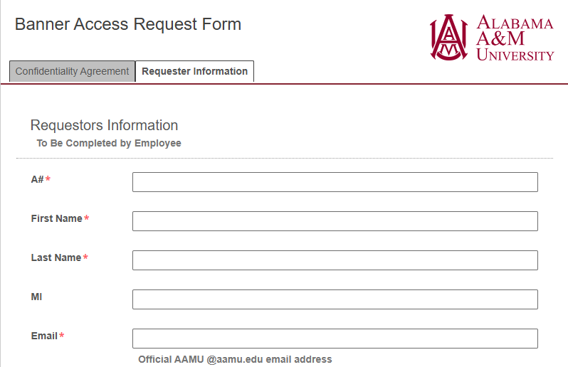
REQUESTING BANNER FINANCE ACCESS
REQUESTOR SECTION
This data is used to help determine what type of access is needed.

Slide 12
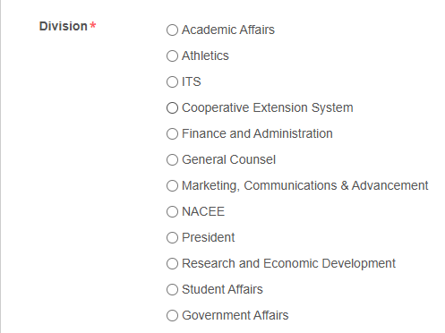
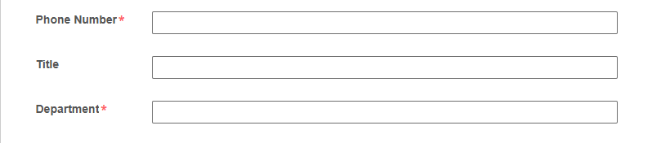
REQUESTING BANNER FINANCE ACCESS
REQUESTOR SECTION
This data is used to help determine what type of access is needed.

Slide 13
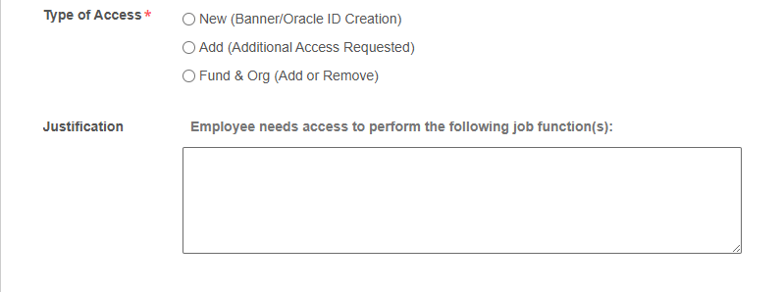

REQUESTING BANNER FINANCE ACCESS
REQUESTOR SECTION
This data is used to help determine what type of access is needed.

Slide 14
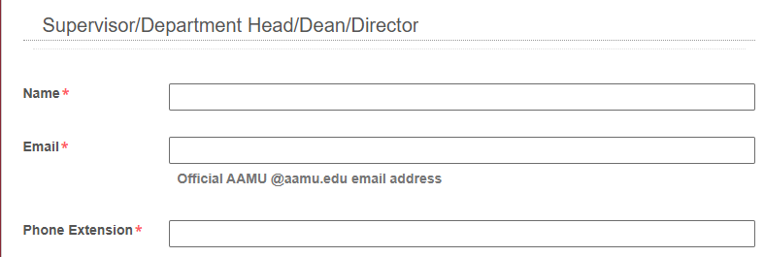
REQUESTING BANNER FINANCE ACCESS
REQUESTOR SECTION
This data determines where your form goes next.

Slide 15
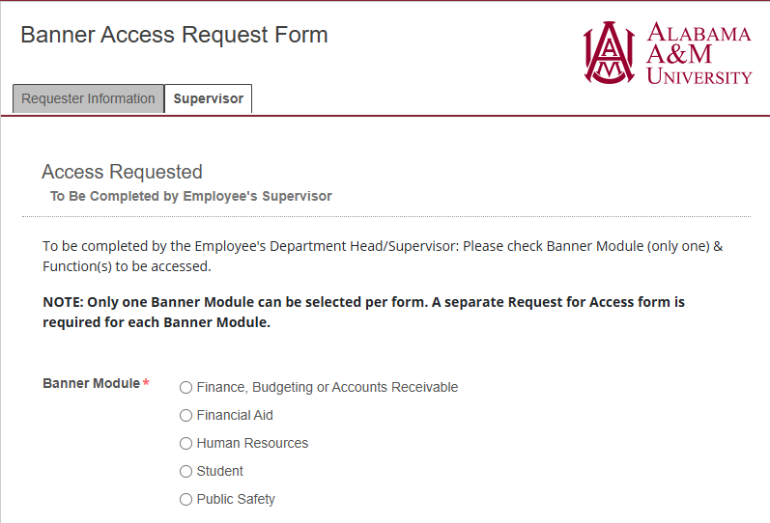
REQUESTING BANNER FINANCE ACCESS
SUPERVISOR SECTION
This data determines where your form goes next.

Slide 16
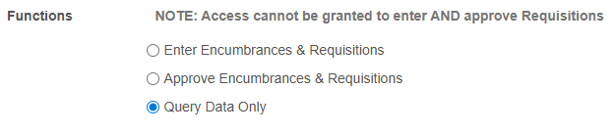
REQUESTING BANNER FINANCE ACCESS
SUPERVISOR SECTION

Slide 17
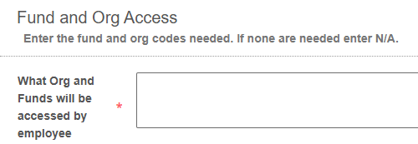
REQUESTING BANNER FINANCE ACCESS
SUPERVISOR SECTION
You may list multiple valid fund/org code combinations.

Slide 18

Alabama A&M University
Purchasing Compliance & Requisition Training
March 24 - 25, 2026
PASSING THE CHECKPOINTS
APPROVAL ROUTING AT AAMU

Slide 19
APPROVAL ROUTING AT AAMU
What is approval routing?
Approval routing is the function in Banner Finance that determines who must review and approve transactions before they move forward in Banner. At AAMU, routing is based on a fund and organization code combination.
Why is approval routing important?
Approval routing helps the University ensure:
  the correct people review transactions
  spending follows university policy
  fund and organization activity is properly monitored

Slide 20
APPROVAL ROUTING AT AAMU
When should a department review approval routing for their fund/org combination?
  A new fund is created (i.e. restricted fund)
  A new organization is created
  An approver is hired, changes roles, or separates
  Departmental responsibilities change

Slide 21
APPROVAL ROUTING AT AAMU
If approval routing is not established for your fund/org combination:
  the requisition cannot move forward for approval
  the requisition sits in Banner and does not process
  the department must pause work and request routing to be created
  the purchase is delayed — sometimes significantly

Slide 22

Alabama A&M University
Purchasing Compliance & Requisition Training
March 24 - 25, 2026
PREPARING THE PATH
ESTABLISHING APPROVAL QUEUES

Slide 23
ESTABLISHING APPROVAL QUEUES
THE BANNER APPROVAL QUEUE SETUP FORM ROUTES AS FOLLOWS:
Requestor
Sponsored Programs
(restricted only)
BPI
Team
Budget Manager
Budget Office
(unrestricted and auxiliary only)
Notes:
High level routing path

Slide 24
ESTABLISHING APPROVAL QUEUES
Banner Approval Queue Setup Form
  Paper forms will not be processed.
  The official form is located in Laserfiche (AAMU Dashboard).
  Each form overrides the last.
  No one person can serve as requisitioner and approver.
  Form must be fully processed before requistions are entered.

Slide 25
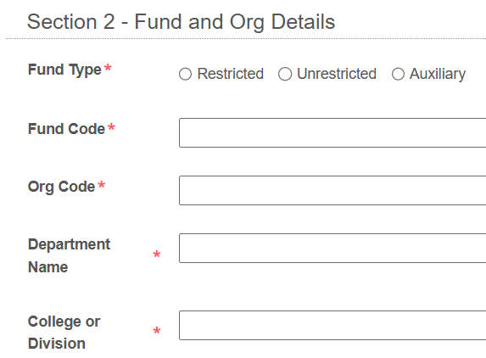
ESTABLISHING APPROVAL QUEUES
Fund Type - Ensures the form routes appropriately.
All other fields help determine routing path.

Slide 26
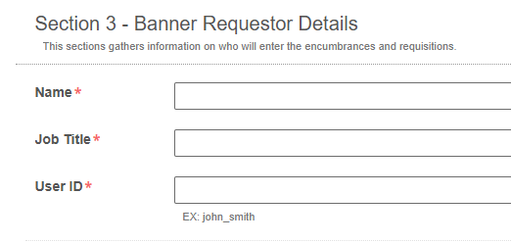
ESTABLISHING APPROVAL QUEUES
The team member entering requisitions is listed here.
Notes:
Section Instructions
This sections gathers information on who will approve encumbrances and requisitions. Having two approvers helps avoid situations in which requests are held up because an approver is unavailable. Do not enter names below, that already appear in Section 3.

Slide 27
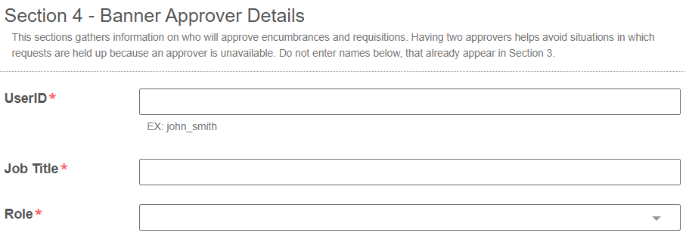
ESTABLISHING APPROVAL QUEUES
Approver information is listed here.

Slide 28
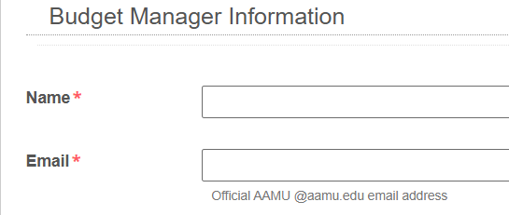
ESTABLISHING APPROVAL QUEUES
This data determines where your form goes next.

Slide 29

Alabama A&M University
Purchasing Compliance & Requisition Training
March 24 - 25, 2026
AVOIDING ROADBLOCKS ALONG THE WAY
COMMON FORM MISTAKES

Slide 30
COMMON FORM MISTAKES
BANNER APPROVAL QUEUE SETUP FORM
  The incorrect fund type is selected.
    Restricted funds often start with “2” and “6”
    Auxiliary funds start with “3”
    Unrestricted fund codes are 100001 and 110000

Slide 31
COMMON FORM MISTAKES
BANNER APPROVAL QUEUE SETUP FORM
  Incomplete or incorrect fund/org combination.
    Fund codes are six digits
    Org codes are five or six digits
  Entering a user as both requisitioner and approver.

Slide 32
COMMON FORM MISTAKES
BANNER ACCESS REQUEST FORM
  Completing one form for multiple module requests.
  Selecting the wrong Banner module.
(EPAFS = HR module)
  Providing only part of a FOAP

Slide 33
Alabama A&M University
Banner Access and Approval Routing Webinar
August 27, 2026
THANK YOU FOR TRAVELING WITH US TODAY!
Division of Business & Finance
Business Process Improvement
BPI Team – bpi@aamu.edu
Alyssa Du Toit - alyssa.dutoit@aamu.edu

