Slide 1



BANNER FINANCE SELF-SERVICE 9
GETTING READY FOR OCTOBER 1
Banner Finance Self-Service 9
Transition Information Session
September 23, 2026

Slide 2

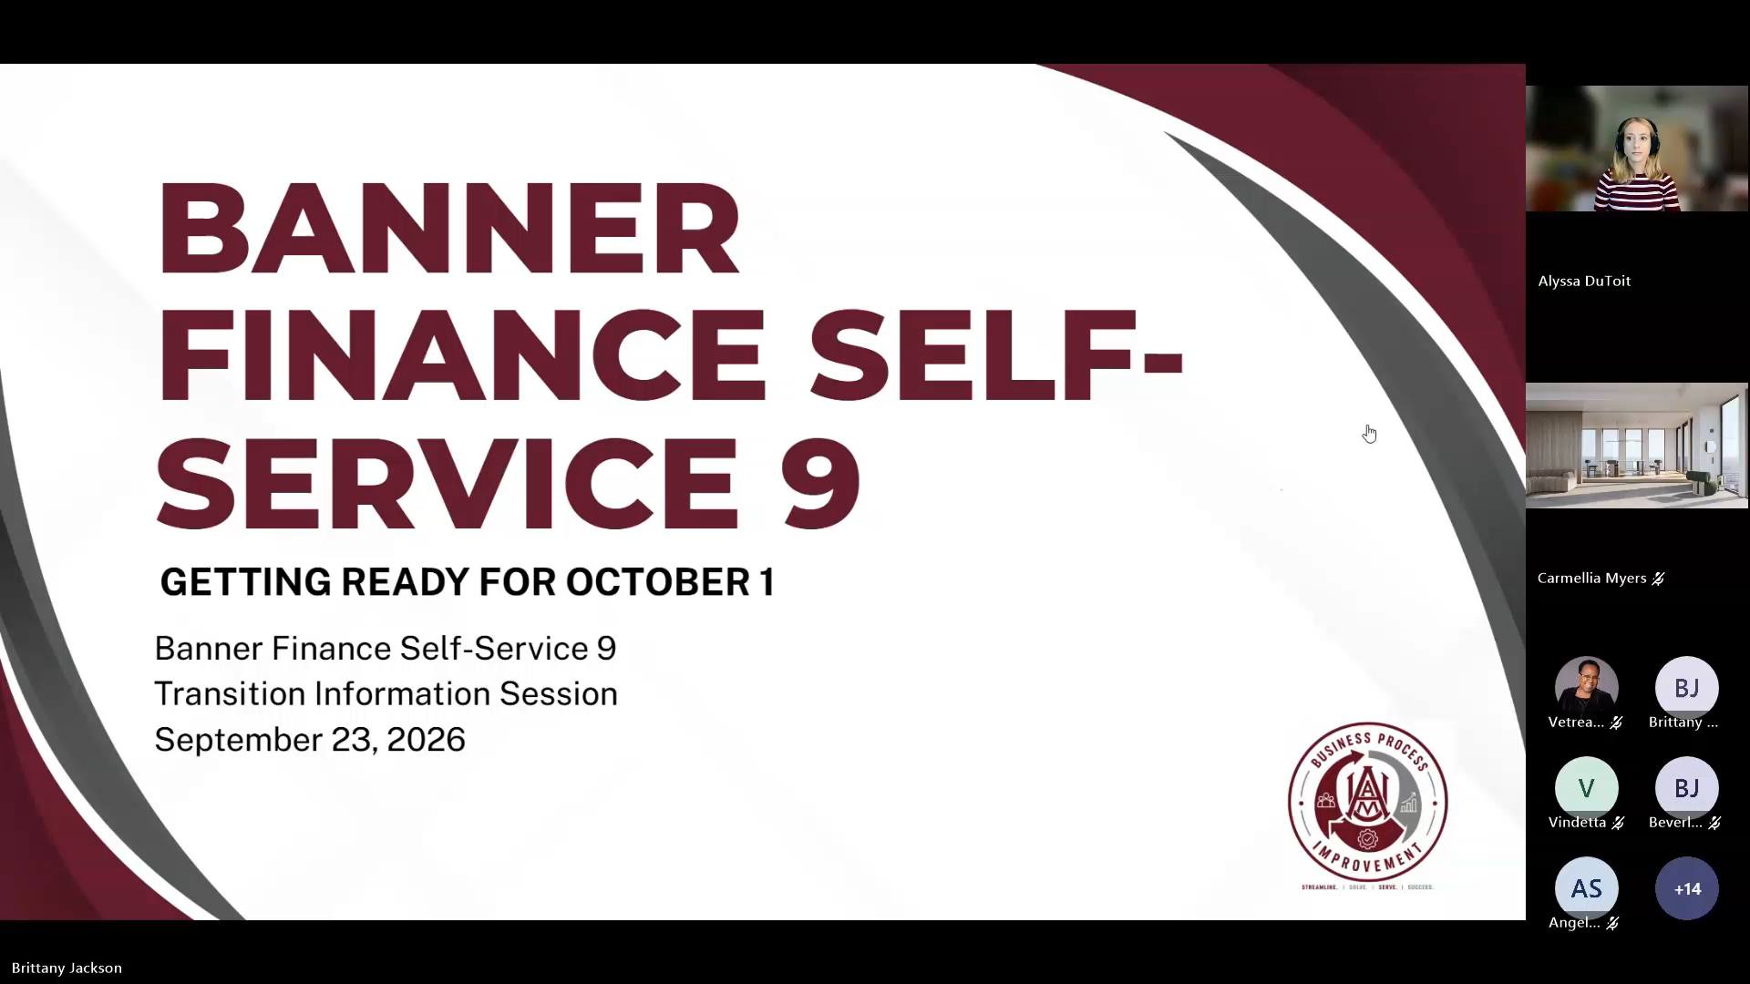
Watch the Webinar!

Slide 3
WHAT IS CHANGING OCTOBER 1?
Beginning October 1:
  Requisitions will be entered in Banner Finance Self-Service 9
  Non-labor budget changes will be entered in Banner Finance Self-Service 9
  Users will use Self-Service instead of Banner Admin Pages for these transactions

Slide 4
WHAT WILL BE DIFFERENT?
  Requisitions are created through My Requisitions
    Use of FPAREQN will be restricted
  Budget transfers are entered through My Journals
    Request forms are still required
    Departments will enter approved transfers into Banner
  Requisitions are subject to budget checking before they can be successfully submitted

Slide 5
TRAINING SESSIONS
  In-Person Training
  Identical Sessions
  September 28 & September 30
  10:00–11:30 AM | ARC Auditorium
  Registration Link will be provided at the end of this webinar

Slide 6
WHAT WE'LL COVER IN TRAINING
  Budget queries
  Non-labor budget changes (budget transfers)
  Requisitions
  Approvals
  Checking document status
  Viewing Finance documents

Slide 7
HELP & RESOURCES
Informational Session
September 23 — Today
In-Person Training
September 28 & September 30
Training Recording
If all goes well, the in-person training will be recorded and made available online.
Written Procedures
Step-by-step procedures are in progress and are expected to be available within one week following the in-person training sessions.

Slide 8
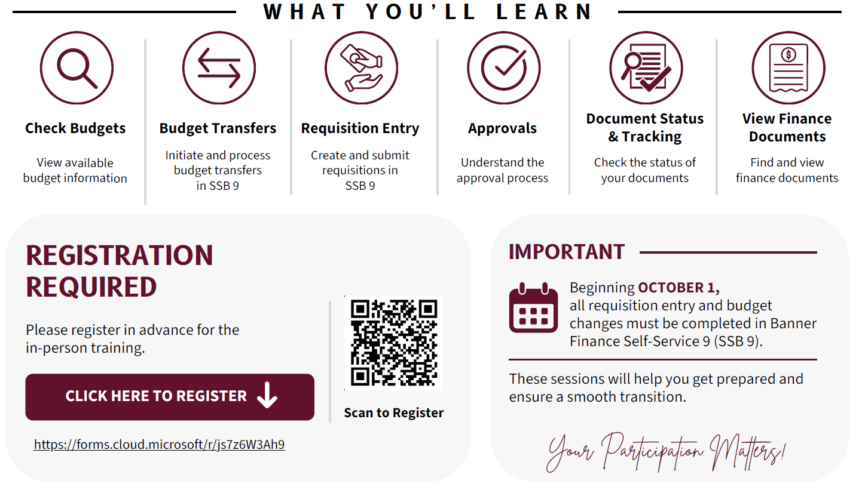
QUESTIONS?

