Slide 1



BANNER FINANCE
SELF -SERVICE 9
Requisitions • Budget Adjustments • Finance Inquiry
Business Process Improvement
Division of Business & Finance

Slide 2

Watch the Recording!
09/30/2026

Slide 3




WHAT CHANGES OCTOBER 1?
Beginning October 1
  Requisitions → Enter in Banner Self-Service
    Your underlying requisition processes remain in place.
    What changes is where the transaction is entered.
  Budget Adjustments → Enter in Banner Self-Service
CHANGE #1
CHANGE #2
COMPLETE ALL REQUISITIONS USING SELF SERVICE BANNER
DEPARTMENTS WILL ENTER BUDGET ADJUSTMENT REQUESTS INTO BANNER

Slide 4

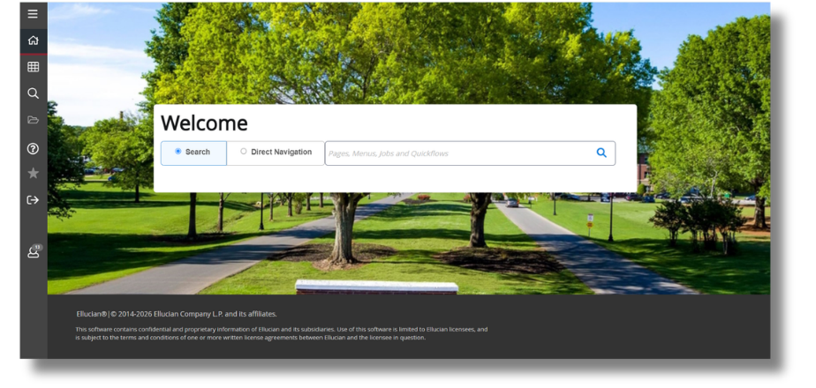
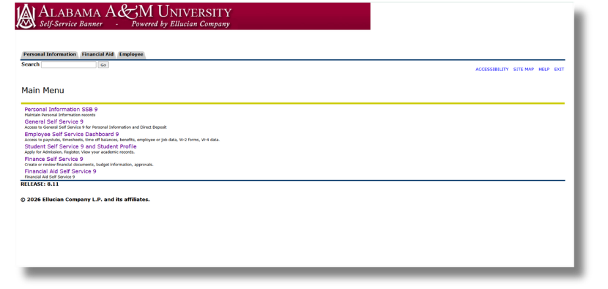
BANNER ADMIN VS. SELF SERVICE BANNER
Banner Admin Pages
Self Service Banner

Slide 5


Finance Query
Budget Adjustments
Requisitions
Approvals
Document Status & Tracking
Help & Resources
TODAY WE’LL COVER

Slide 6


“FOAP” Overview
Understanding Fund, Org, Account and Program Codes
FUND
ORGANIZATION
ACCOUNT
PROGRAM
Defines the funding source
Defines the budgetary responsibility
Identifies financial activity or object
Defines the functional purpose
  Six characters in length
  Categorized as
    Unrestricted (1)
    Restricted (2, 6)
    Auxiliary (3)
    Agency (8)
  Five or six characters in length
  Most times called an “org”
  Identifies the department
  Five characters in length
  Objects are income, expenses, assets, liabilities, transfers and others
  Three characters in length
  Examples are Academic Support, Student Services, Research, etc.

Slide 7

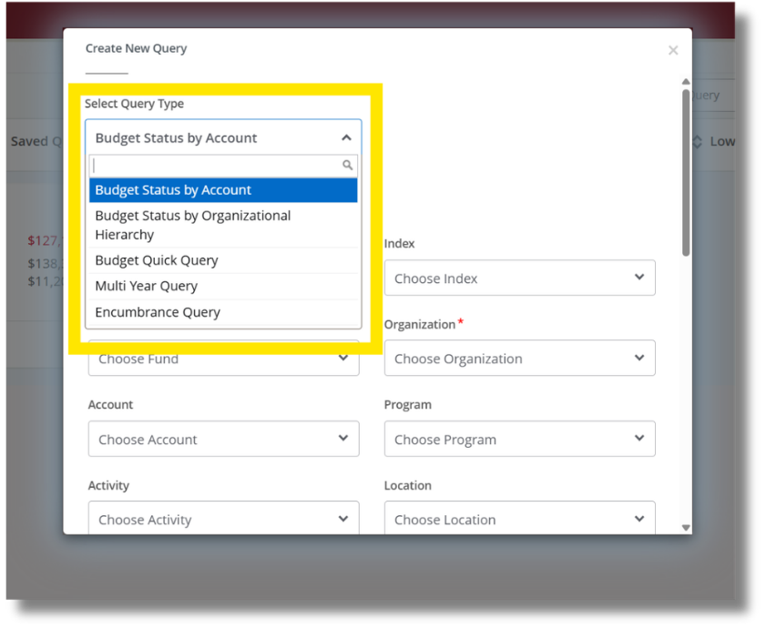

MY FINANCE QUERY
Use Finance queries to review budget and transaction information.
Today we’ll demonstrate:
  Budget Status by Account
  Multi-Year Query

Slide 8


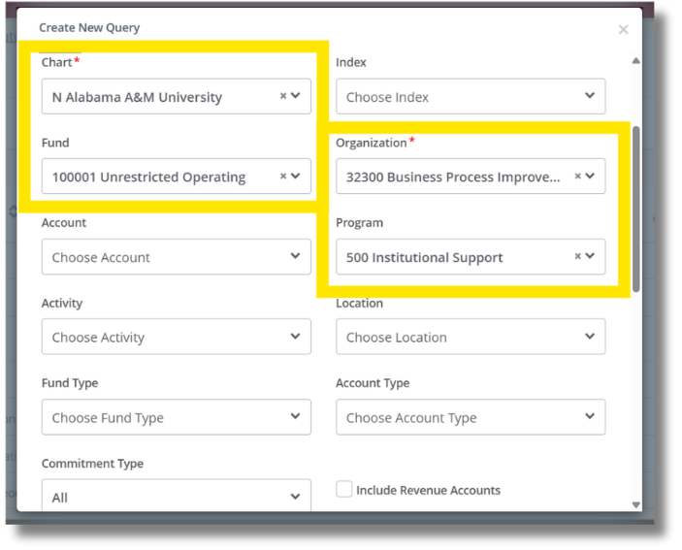
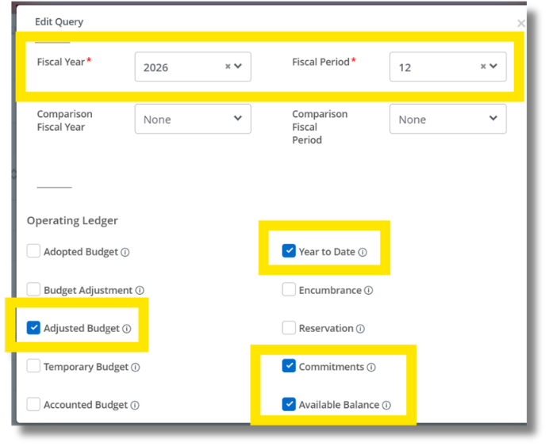
BUDGET STATUS BY ACCOUNT
Review budget information by account.

Slide 9
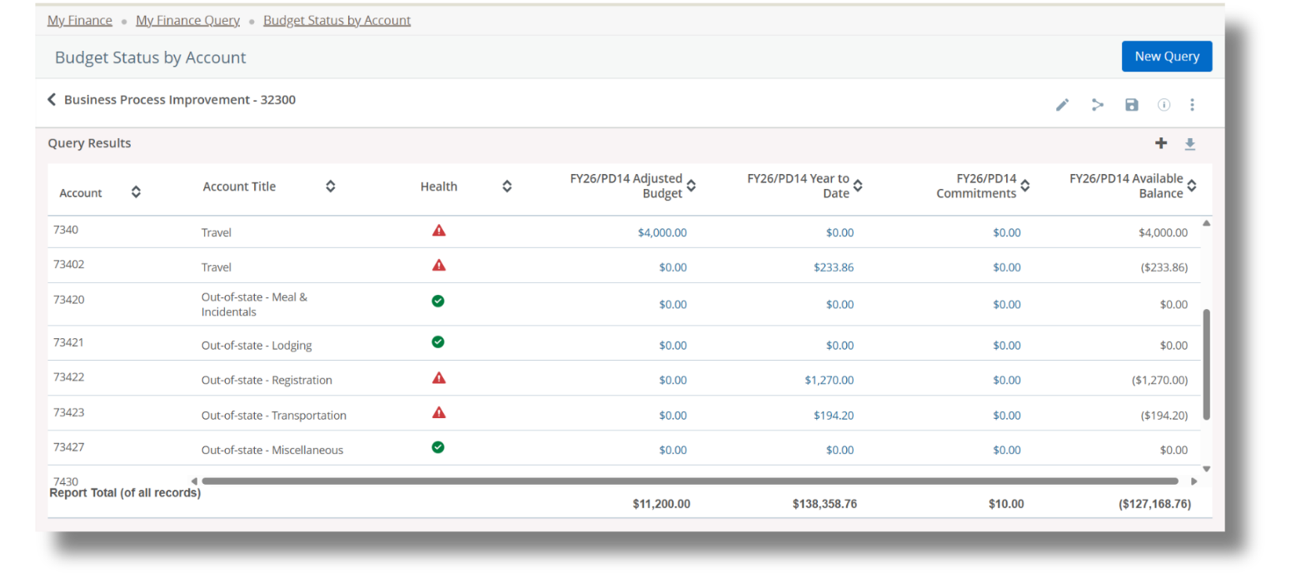
BUDGET STATUS BY ACCOUNT
Review budget information by account.

Slide 10
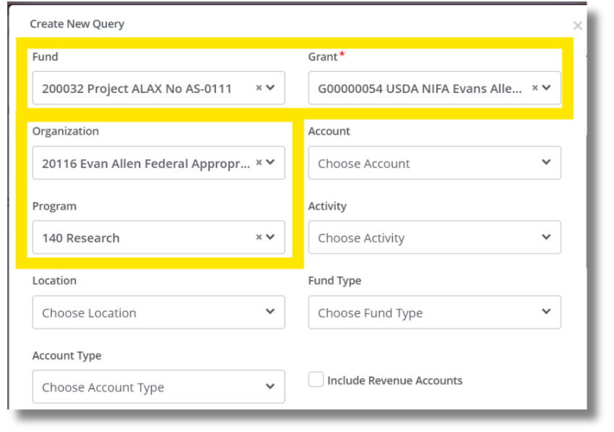
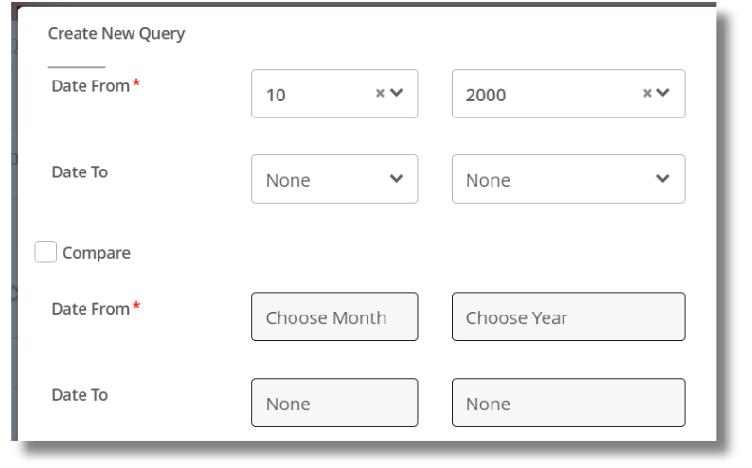
MULTI-YEAR QUERY
Review financial activity across multiple fiscal years.
Particularly useful for restricted funds.

Slide 11
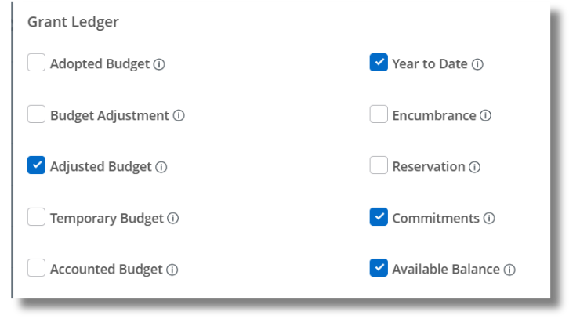
MULTI-YEAR QUERY
Review financial activity across multiple fiscal years.
Particularly useful for restricted funds.

Slide 12
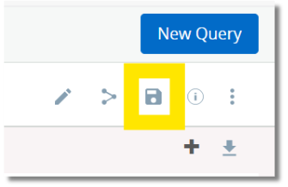
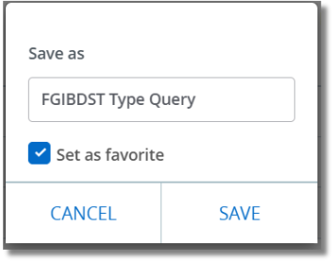
DON'T REBUILD THE SAME QUERY EVERY TIME.
  Save — Keep a query for future use
  Favorite — Make frequently used queries easier to access
  Share — Use with caution

Slide 13
BANNER ADMIN INQUIRY IS STILL AVAILABLE
These inquiry pages are not going away just yet.
  FGIBDST — Budget Status
  FGIBAVL — Budget Availability
  FRIGITD — Grant Inception-to-Date

Slide 14

Budget Status by Account
Review budget information by account using selected fiscal and FOAP criteria.
Multi Year Query
Review grant budget activity across multiple fiscal years or date ranges.
MY FINANCE QUERIES
Budget Status by Organizational Hierarchy
Review budget information across an organizational hierarchy.
Encumbrance Query
Review encumbrance and commitment information for a selected fiscal year and period.
Budget Quick Query
Quickly review budget status, including Adjusted Balance, Year to Date, Net Commitments, and Available Balance.

Slide 15


BUDGET ADJUSTMENT PROCESS (CURRENT)
1
2
3
4
5
5
OSP or Budget Office approves paper request
GCA or Budget Office enters journal into Banner
GCA or Budget Office approves journal in Banner
Dept completes paper request
Dept approves paper request

Slide 16


BUDGET ADJUSTMENT PROCESS (OCT. 1)
1
2
3
4
5
OSP or Budget Office approves paper request
GCA or Budget Office approves journal in Banner
Dept enters journal into Banner
Dept completes paper request
Dept approves paper request

Slide 17

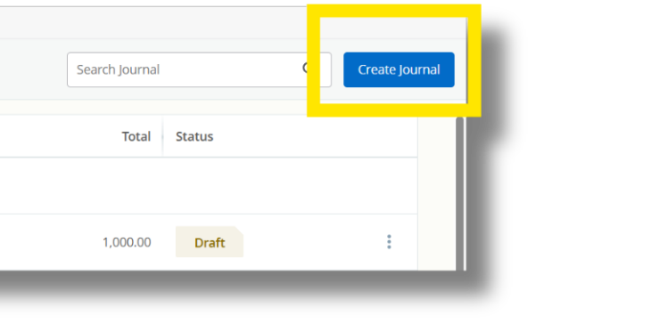
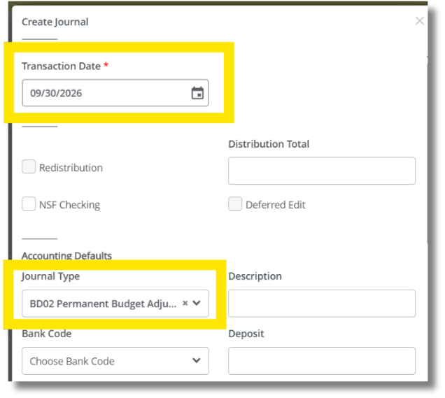
MY JOURNALS
Creating the journal

Slide 18

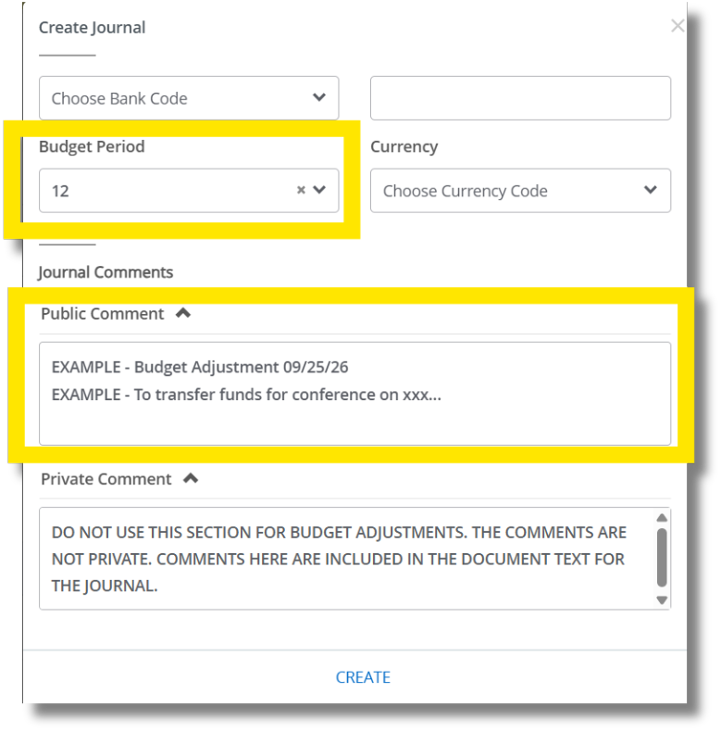
MY JOURNALS
Creating the journal

Slide 19
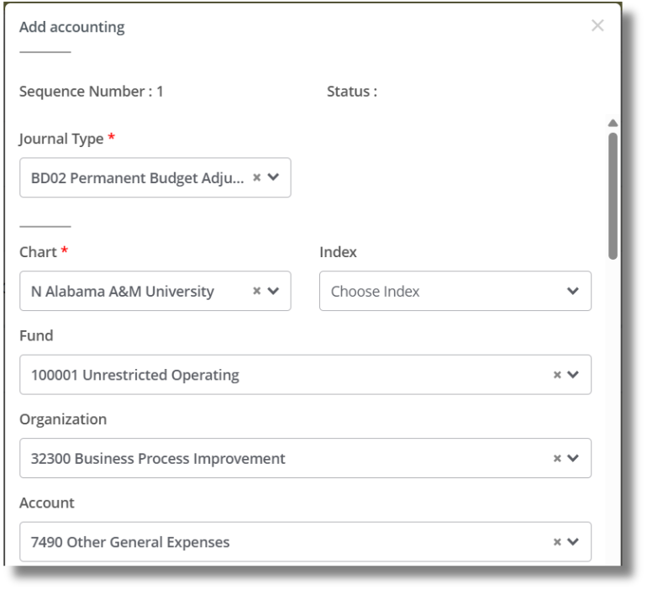
MY JOURNALS
Data auto populates
Add Accounting
Data user enters

Slide 20
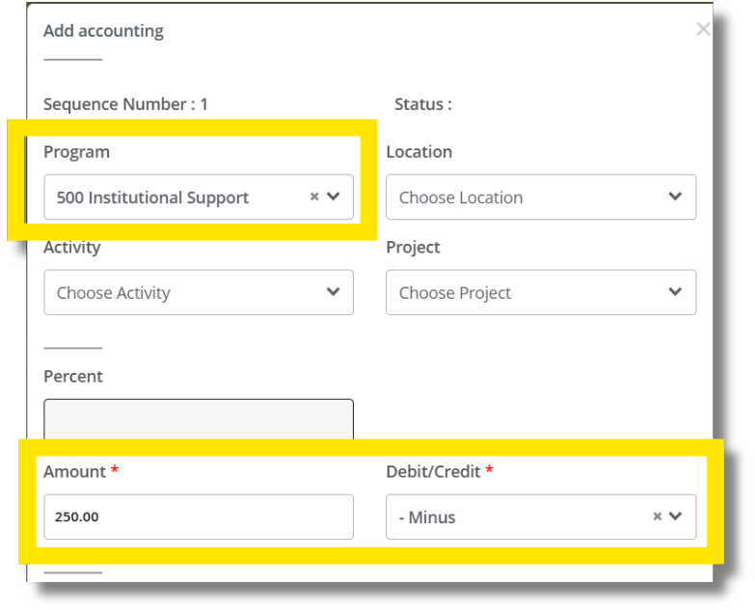
MY JOURNALS
Data auto populates
Add Accounting

Slide 21

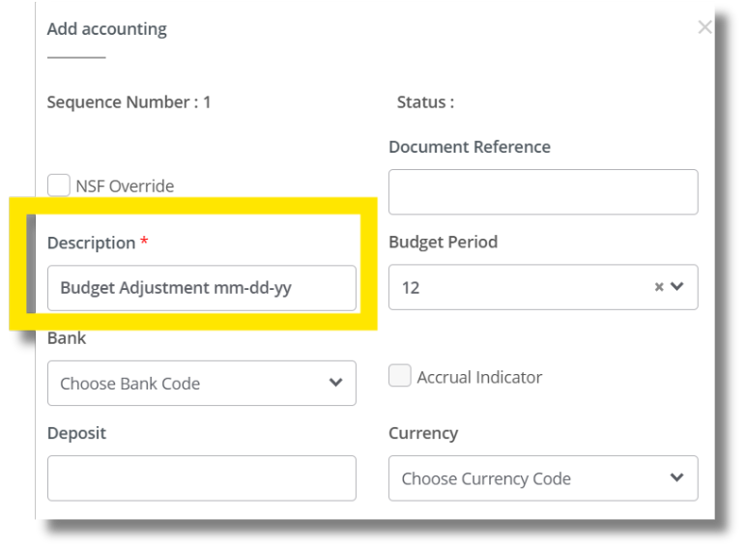
MY JOURNALS
Add Accounting

Slide 22
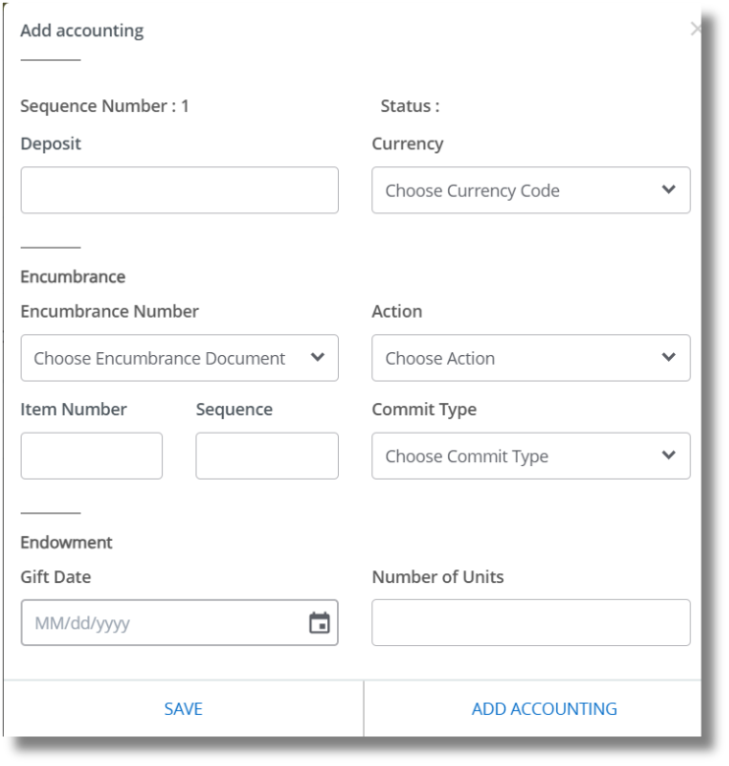
MY JOURNALS
Add Accounting
Repeat for “plus” (+) side of the entry then choose SAVE

Slide 23

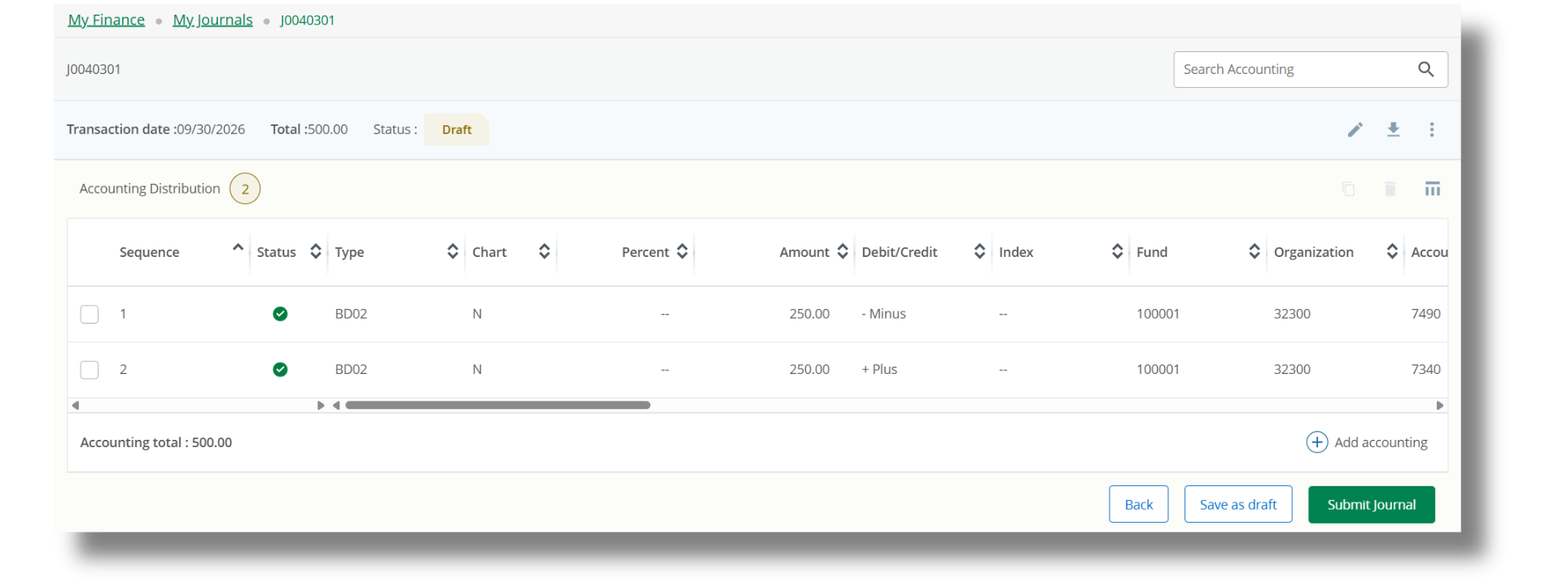
MY JOURNALS
Submit for Approval
Submit button may be a different color in production

Slide 24

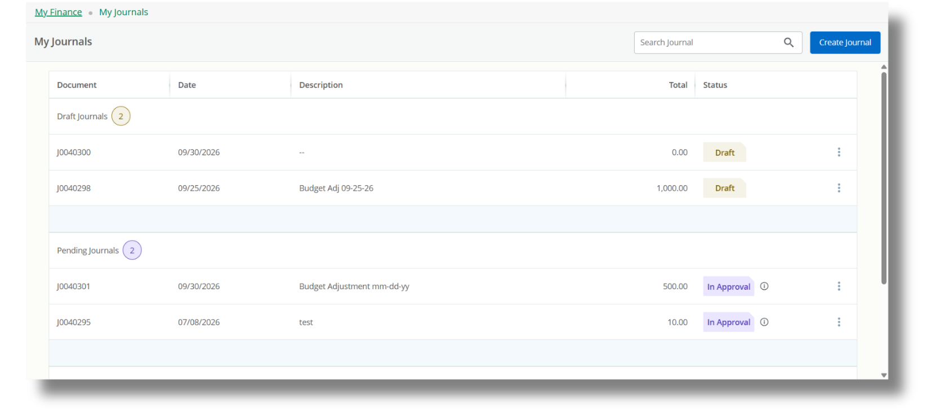
MY JOURNALS
Journal Tracking
Journal moves from Draft to Pending after submission

Slide 25
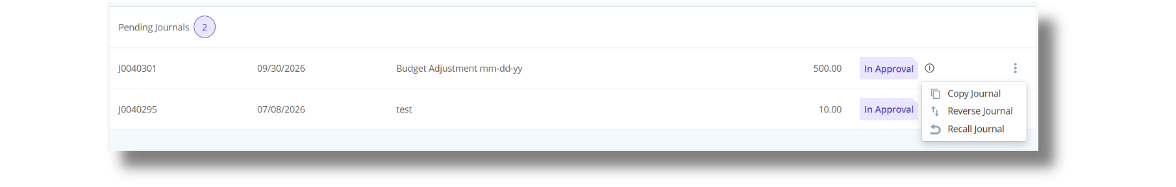
MY JOURNALS
Recalling a Journal

Slide 26



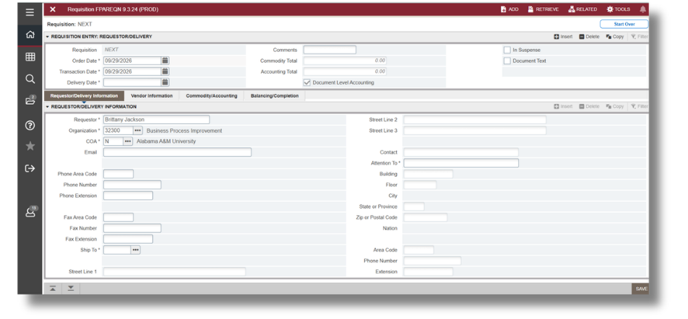
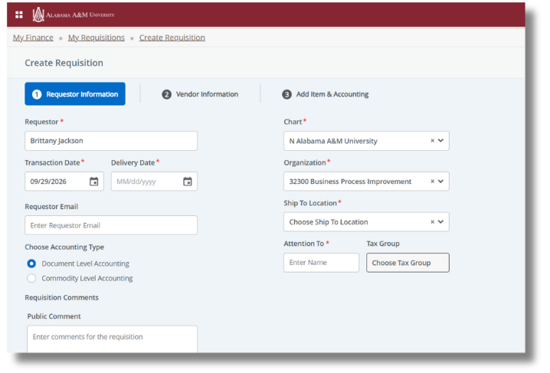
MY REQUISITIONS
FPAREQN
Self Service Banner

Slide 27

MY REQUISITIONS
1
2
3
4
5
Add Requestor Info
Add Vendor Info
Add Items to be Purchased
Add Accounting (FOAP)
Submit for Approval

Slide 28

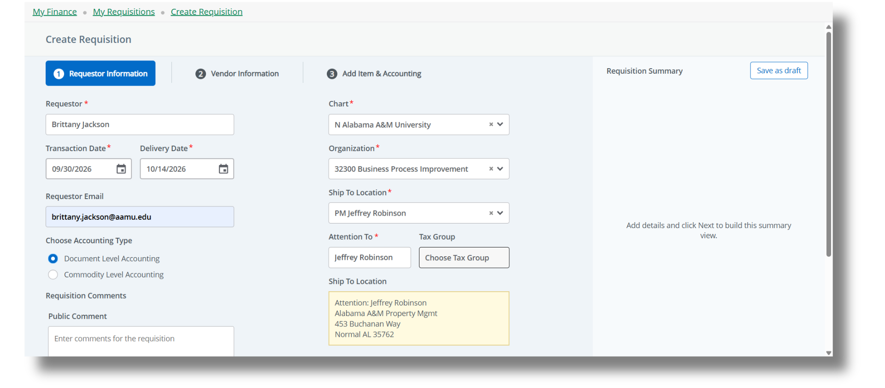
MY REQUISITIONS
Requestor Info
Requisition data populates on right side of screen.
Click Next at the bottom.

Slide 29

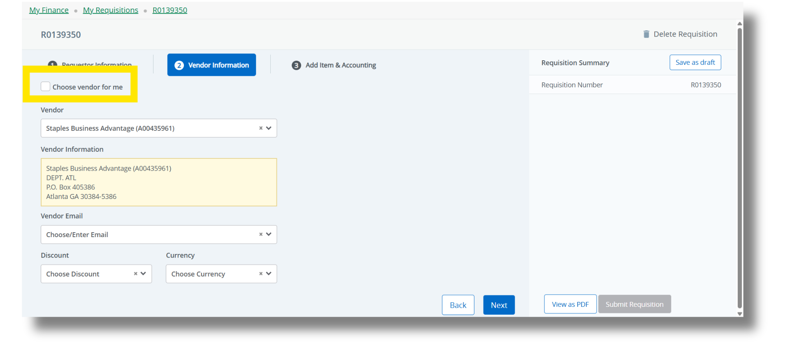
MY REQUISITIONS
Vendor Info
uncheck
select a vendor
click Next

Slide 30

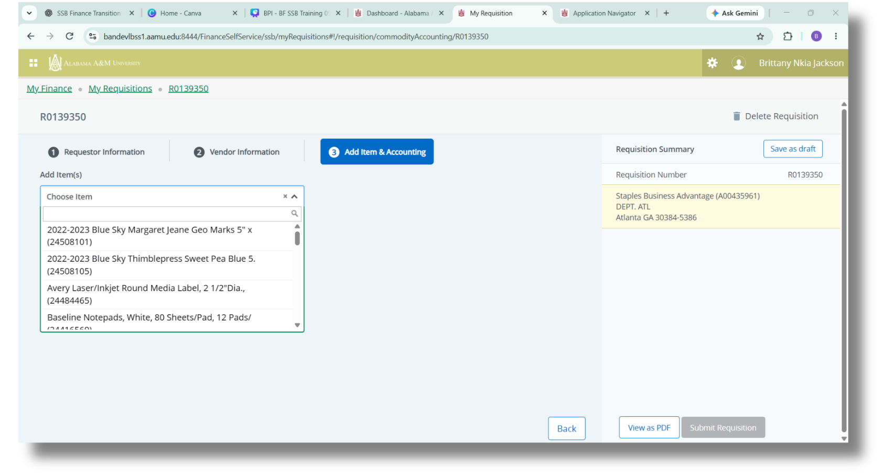
MY REQUISITIONS
Items to Purchase
Begin typing the item to purchase based on your quote.

Slide 31

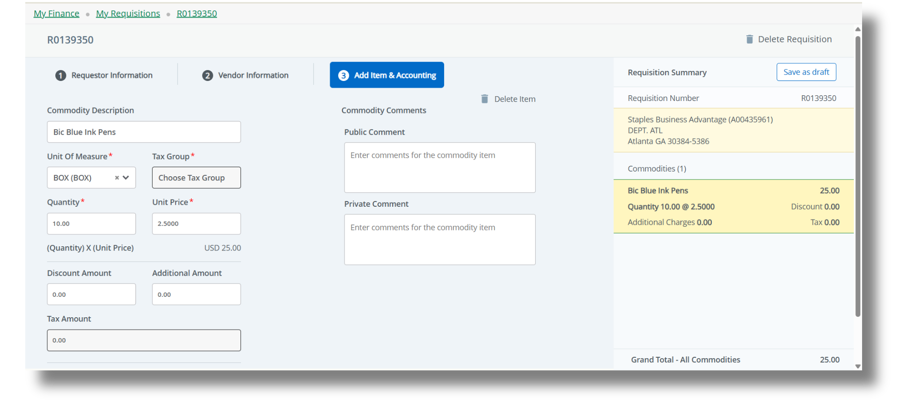
MY REQUISITIONS
Items to Purchase
Enter item details and click Save button below.

Slide 32

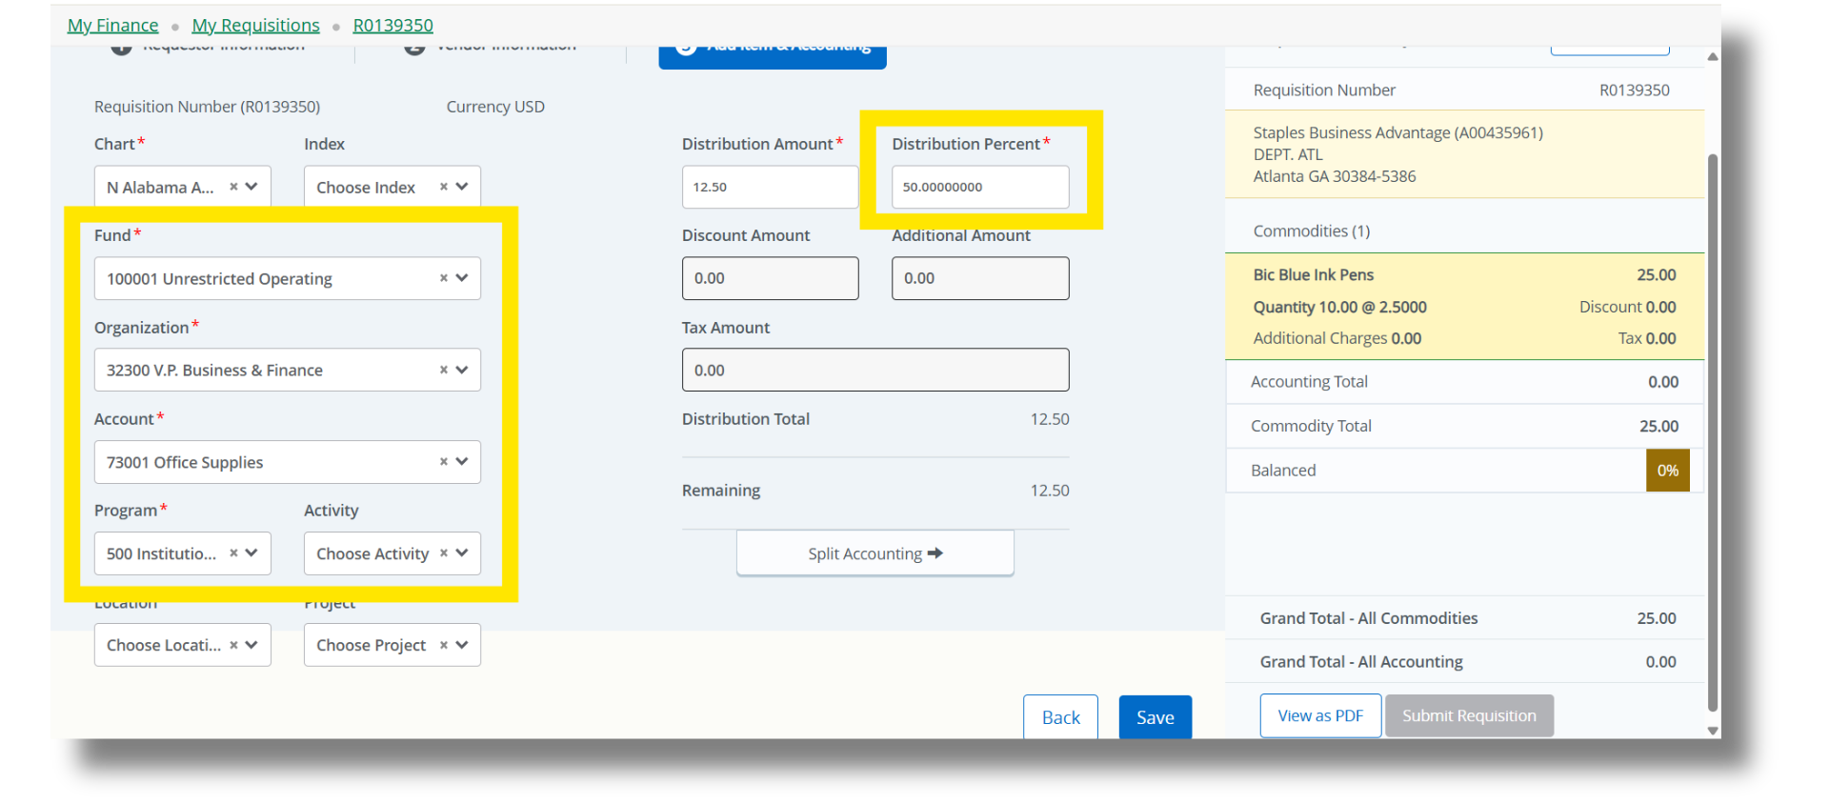
MY REQUISITIONS
Add Accounting

Slide 33
MY REQUISITIONS
Add Accounting

Slide 34

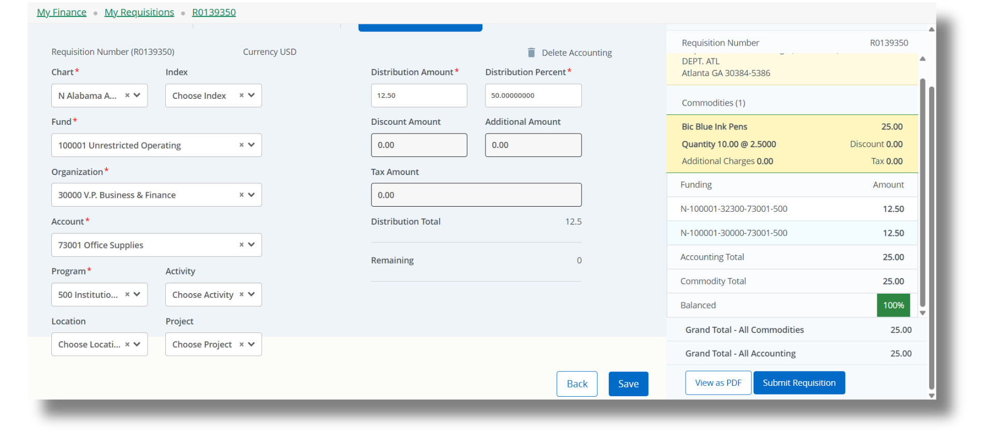
MY REQUISITIONS
Add Accounting

Slide 35

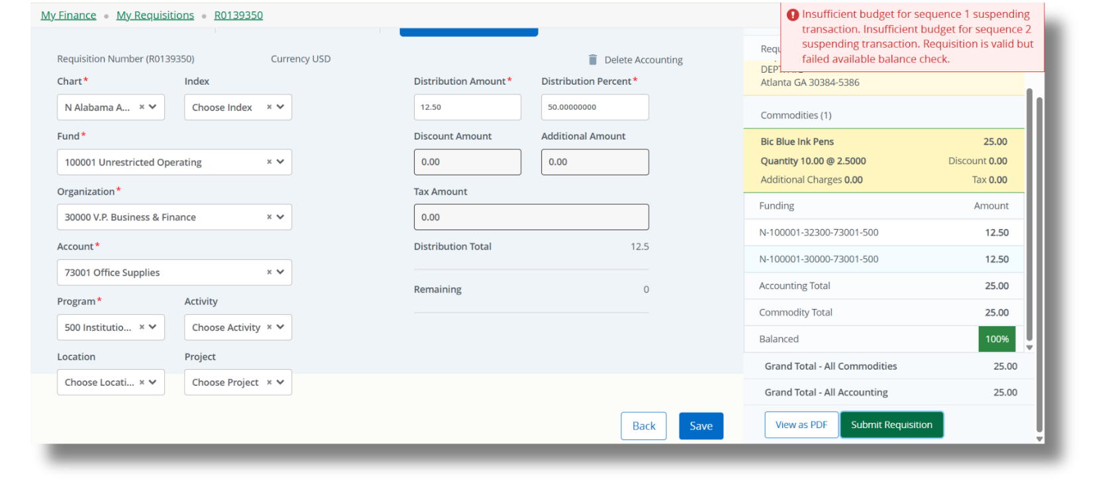
MY REQUISITIONS
Submission NSF

Slide 36
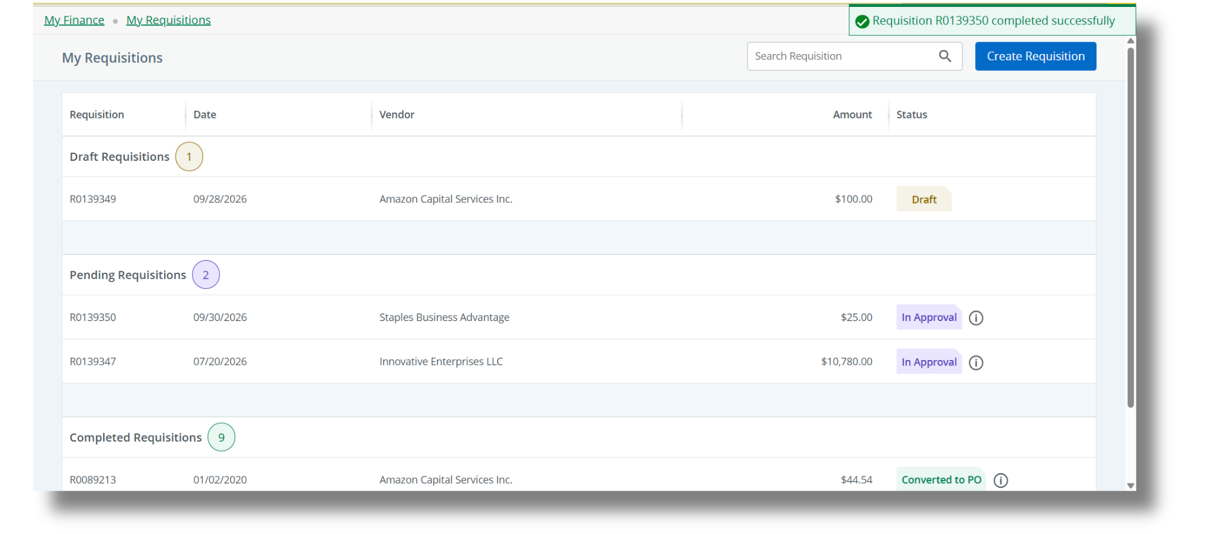
MY REQUISITIONS
After Submission
incomplete requisitions
requisitions in approvals
awaiting or converted to PO

Slide 37

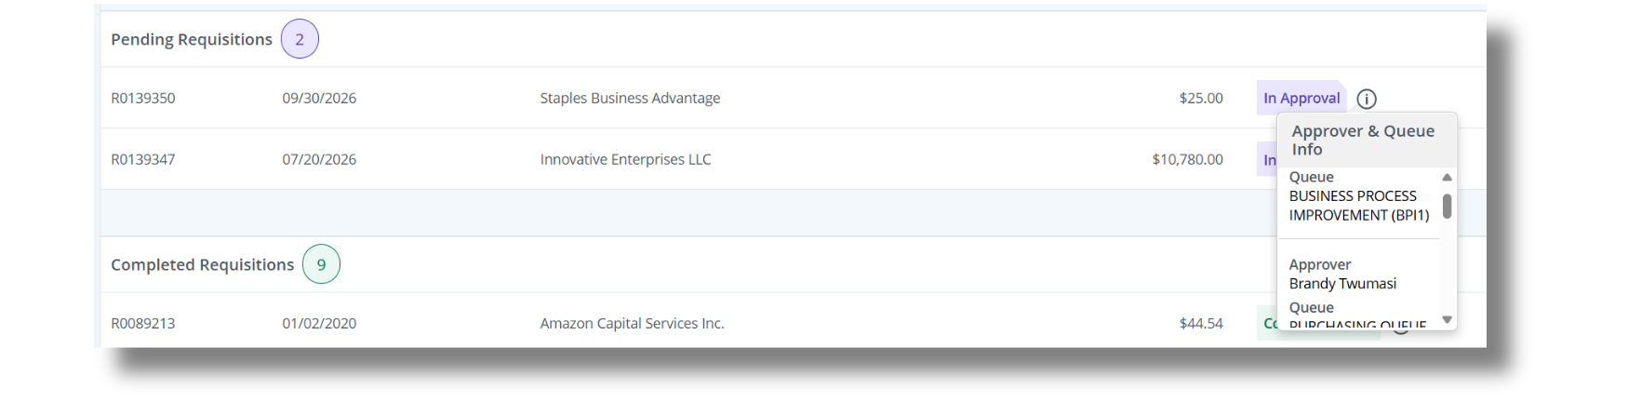
MY REQUISITIONS
After Submission
Click the “i” icon to see approval queue information.

Slide 38
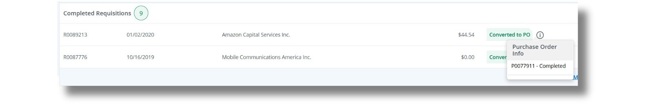
MY REQUISITIONS
After Submission
Click the “i” icon to see purchase order information.

Slide 39

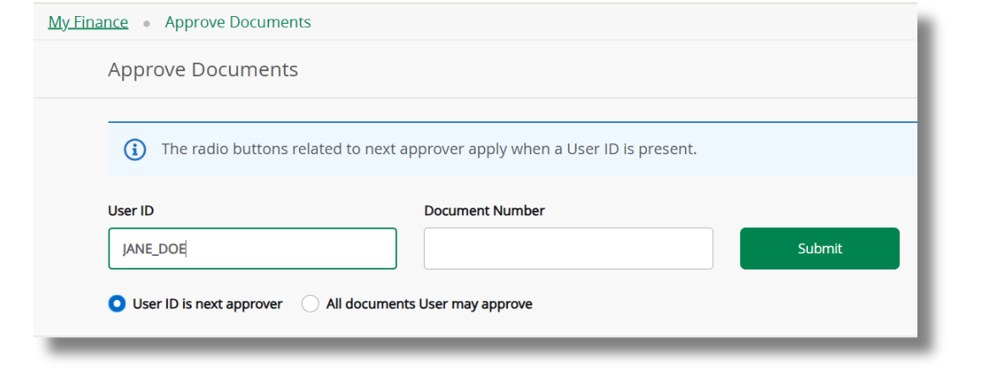
APPROVE DOCUMENTS
Click Submit to view all documents where you are the next approver.
User ID will auto-populate.

Slide 40

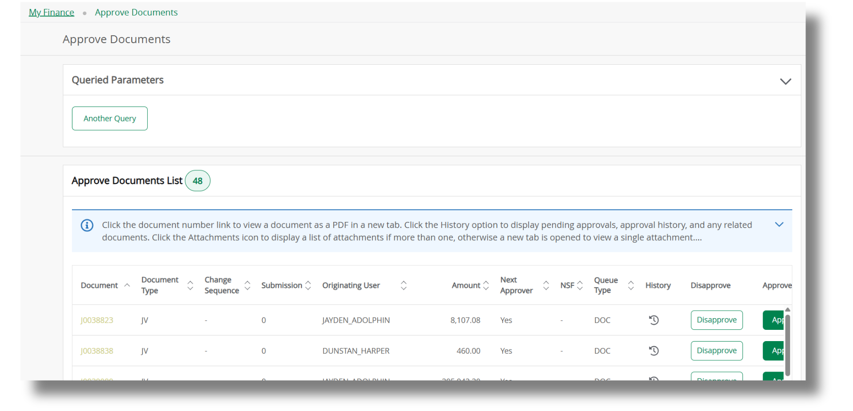
APPROVE DOCUMENTS

Slide 41

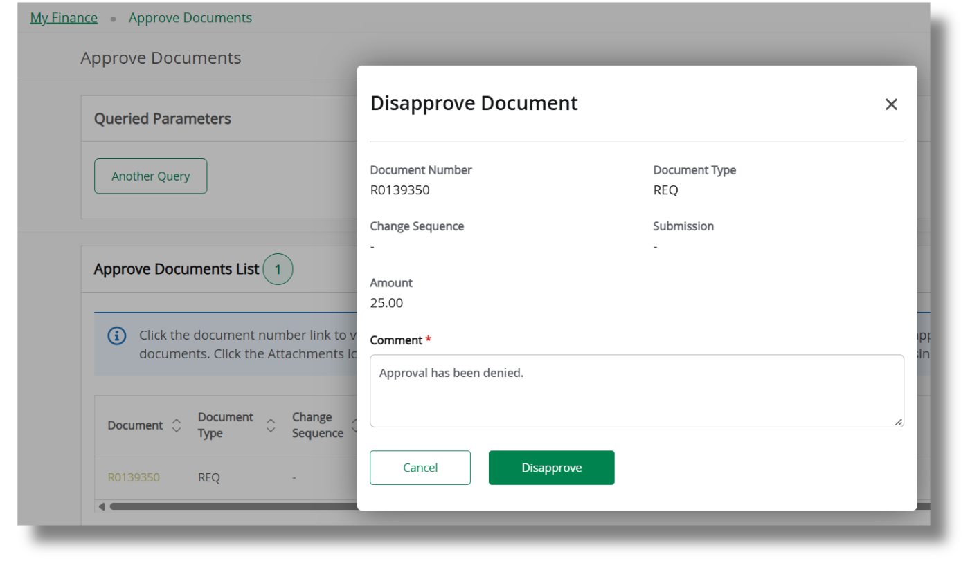
APPROVE DOCUMENTS
Disapprove

Slide 42
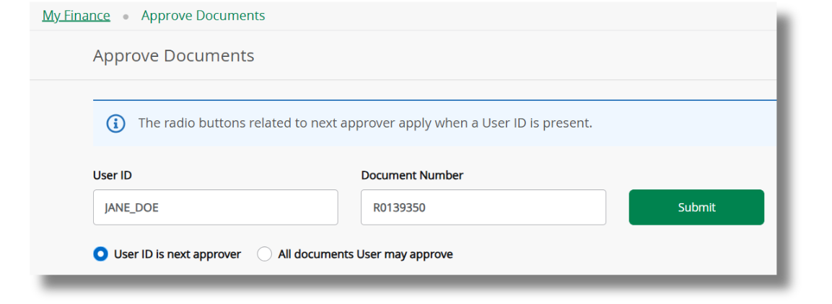
APPROVE DOCUMENTS
Click Submit to view only what’s in the Document Number field.
Enter the requisition number.

Slide 43

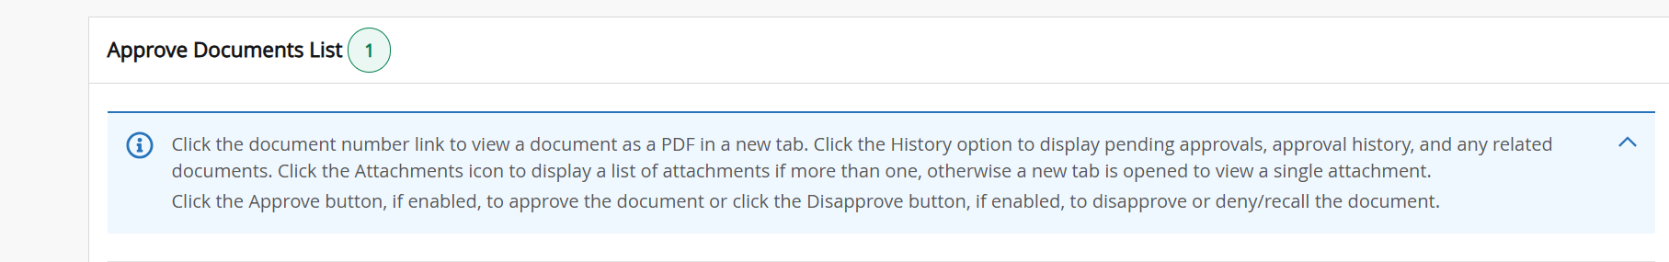
APPROVE DOCUMENTS
* Detailed Help Hints *

Slide 44

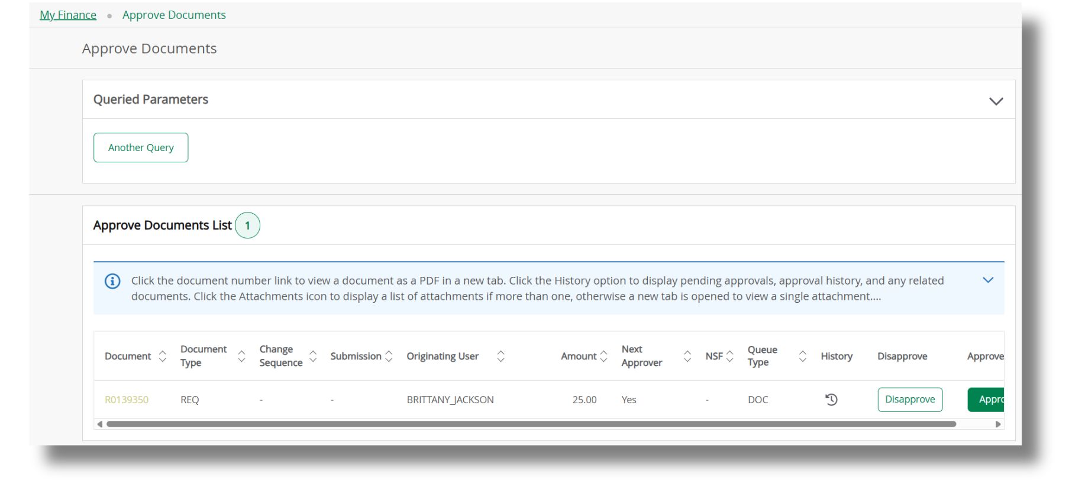
APPROVE DOCUMENTS
Click the requisition number to review.

Slide 45

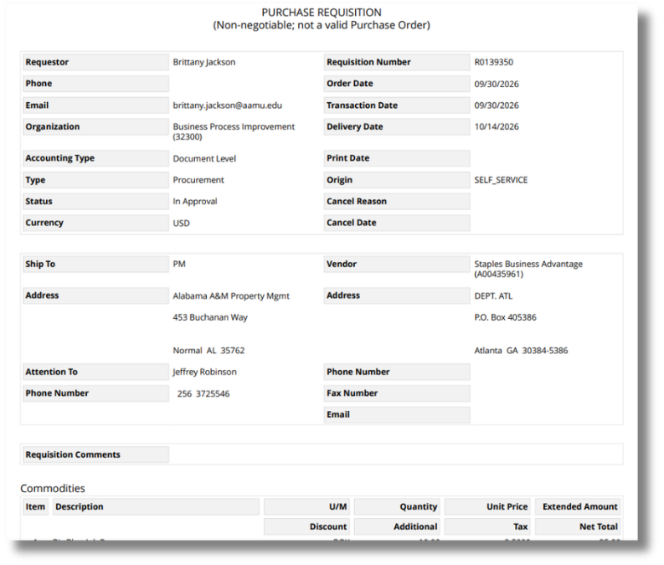
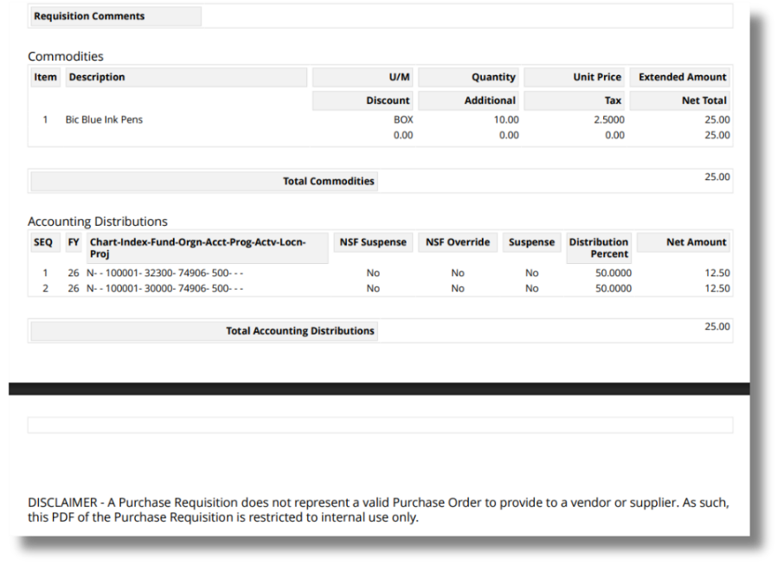
APPROVE DOCUMENTS

Slide 46
APPROVE DOCUMENTS
Click the History icon to review approval history.

Slide 47
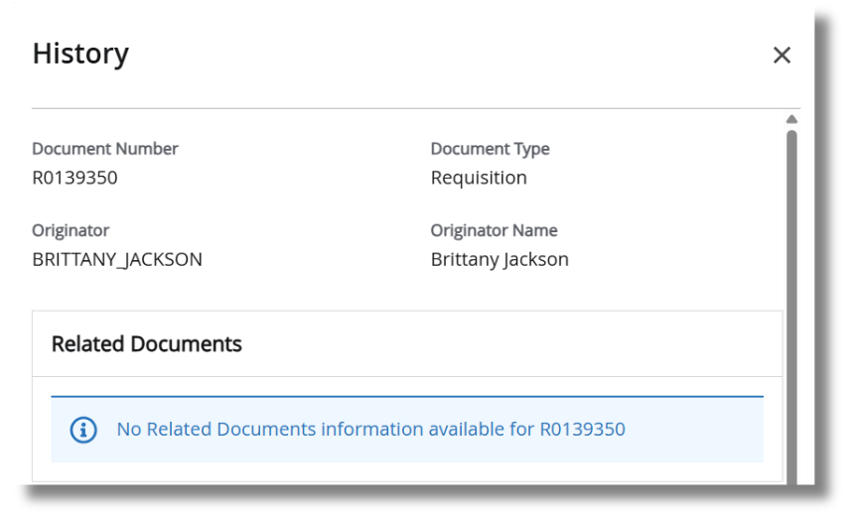
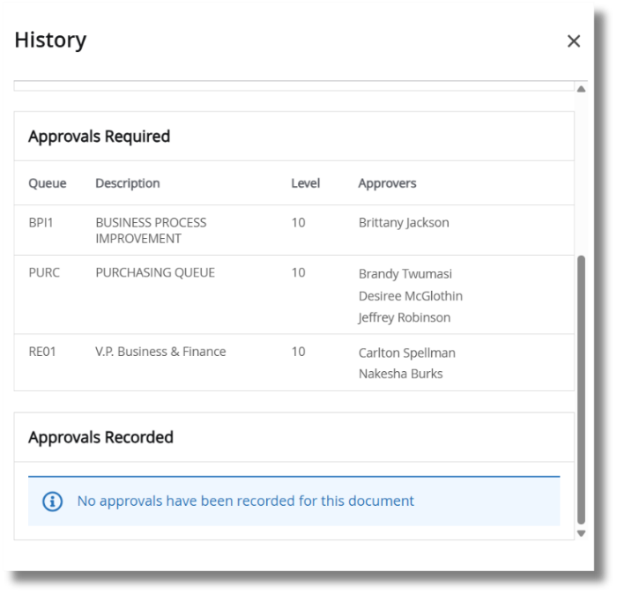
APPROVE DOCUMENTS
Approval History

Slide 48
THANK YOU FOR ATTENDING!
GOT QUESTIONS?
Business Process Improvement (BPI)
Division of Business & Finance
BPI@aamu.edu
Brittany Jackson, ERP Manager
Alyssa Du Toit, Business Systems Analyst
September 30, 2026

