Slide 1
Graduate Studies
Alabama A&M University
AUDIT & CLEARANCES

Slide 2
Grad Event 2021
Congratulations!!!
You have crossed a major milestone …
… Now, just a few points to keep in mind

Slide 3
Grad Event 2021
Look Closely and Follow Your Audit
Comply with instructions from your audit report …
- Programs of Study
Do you have proper signatures?
Are all proper courses reflected?
Have you dropped any courses?

Slide 4
Grad Event 2021
Clearance
Graduate Studies only clears “Academically”
Review the Graduation Clearance Screen to find OTHER
graduation clearance requirements.
http://galileo.aamu.edu/graduationclearance/student_login/login.asp
These may include …
- Clearance from the Business Office
- Clearance from Financial Aid Office

Slide 5
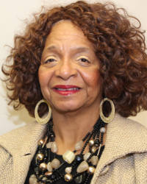
Grad Event 2021
All communications for
Mrs. Marilyn Saintjones
should be sent to
marilyn.saintjones@aamu.edu

Slide 6
Grad Event 2020

