Slide 1
Making Something Out of Nothing!
Finding the Words to fill the Page
Dr. Kem Roper, Director
June 18, 2020

Slide 2
What do we mean by “Process”?
WHAT IT’S NOT
Linear
intro, body, conclusion
WHAT IT IS
Recursive
questioning, thinking, drafting

Slide 3
Fact: “Real” writers suffer from writers block
Forgive: Release yourself from the need to be perfect
Give yourself time to write badly
Forget: Put the critic in the closet
Fun: Explore!
Exercise
Set yourself up for success
Focus: Tie yourself to the chair

Slide 4
What do we mean by “Process”?
The process requires:
Time
Thinking
Spacing

Slide 5
So, how do I begin?
Give yourself AT LEAST 3 days before the due date to write
Give yourself a different task for each day
Save editing for the last day

Slide 6
If you only have 3 days…
Day 1: think & free write
Day 2: read, think, write & re-write
Day 3: read, think, revise, edit (print & rejoice!)

Slide 7
If you have more than 3 days…
Day 1-3: think and free write
Day 3-5: read, think, write & re-write
Day 5-7: read, think & revise
Day 8: read, think, edit, print & rejoice!

Slide 8
LET US HELP!
The best time to come to the writing center is early in your process.
(DAY 1 OR 2)
We do our best work at the beginning!

Slide 9
Day 1: think and free write
What is my topic?
What are the specific issues related to this topic?
What are the specific issues that I want to focus on?
What do I already know about this?
What opinions do I have about this?
Where do my thoughts and opinions come from?
Experiences, observations, personality, family/upbringing

Slide 10
Day 1: think and free write
What does the assignment require?
What questions must be answered or what information included?
Gather what you need…
If you’re doing research, look for sources that will help to answer these questions
BUT YOU ANSWER THE QUESTIONS FIRST!

Slide 11
if you’re doing research…
You’re question to yourself should be: how does this information compare to what I already know?
Does it confirm, refute or enrich my understanding of this topic?
Write down your answers to these questions!

Slide 12
Day 1: techniques
Free-writing
Listing (or clustering)
Speaking into recorder
Conversing
Generate Ideas:
5Ws (journalist questions)
5 Senses (Look, Touch, Taste, Feel, Smell)

Slide 13
PRACTICE!
I’ll set the timer and for the next 5 minutes practice one of the Day 1 writing techniques
Free-writing
Listing (or clustering)
5Ws (journalist questions)
5 Senses (Look, Touch, Taste, Feel, Smell)

Slide 14
Day 2: read, think, write & re-write
Read what you wrote on Day 1
Think about it. What can you add?
What should you change?
Do your responses answer the important questions?
What is missing?
Which questions can you not answer?

Slide 15
Day 2: read, think, write & re-write
If you’re writing a research paper, the questions that you can’t answer should point you to the resources you need to look for
Spend some time reading & taking notes on the reading (Go to the “Write Place” website “Tutorials”)
If you have a long research paper to write, your “day 2” may need to stretch out to day, 3, 4 and 5!

Slide 16
Day 2: read, think, write & re-write
If you’re not doing research or once you’ve read and taken notes on your reading…
Think about what you have written and how it can be structured
If there are questions you can’t answer, include the limitations in your writing or shift your focus to what you do know
To determine what to keep and what to toss, consider your purpose and audience

Slide 17
Day 2: read, think, write & re-write
This might be where some of you get stuck!
You’ve explored the topic, written what was on your mind and you still only have 2-3 pages of what should be a longer essay
NOW WHAT?

Slide 18
How do I “Say More?”
If you’re writing a research paper, “saying more” is fairly easy because you must balance what you say with what “they” which often provides many opportunities to elaborate.
For more on responding to sources, attend our upcoming workshop on “Writing the Lit. Review”

Slide 19
How do I “Say More?”
Whether your writing a research paper or not, try this!
Think about the main point that you want to make
Can you find a working thesis in your draft so far?
Take one statement that asserts a point/perspective and follow the S.E.E.I formula to develop

Slide 20
Technique for “How to Say More”
S.E.E.I
State—write the statement
Elaborate—follow with an elaboration on that statement (“in other words…”)
Exemplify—give an example that shows an actual instance of that thing
Illustrate—give an illustration that compares that thing to something that it’s “like”

Slide 21
SEEI Example
State—Writing can be hard.
Elaborate—Thoughts come to us randomly, sporadically and at different times, so we have to take the time to think things through.
Exemplify—When I have a paper to write, I spend a lot of time figuring out what I want to say. My ideas are usually all over the place at first, so I have to make lists or free write for a while before I actually start.
Illustrate—Writing is like organizing your sock drawer. You have to dump out all the ideas first, then put them together one by one until all of the like things are together!

Slide 22
Now you try!

Slide 23
Day 2: read, think, write, re-write
Continue using SEEI for every point that you make. This method should help you to effectively elaborate on each point
Do this exercise over a couple of days, not all in one sitting
Allow yourself time to read and re-read what you’ve written

Slide 24
Day 3: read, think, revise
Organize!
Once you have some “stuff” to work with you can begin organizing what you’ve written
Now is the time to think about the structure of your essay
Who is your audience?
What does the professor require?

Slide 25
Day 3: read, think, revise
Outline
Introduction (how can I set up this discussion?)
Thesis (what is my main point?)
Background Information (what information would my reader need in order to know what I know?)
Supporting Information (what will I use to support my main point?)
details, examples, research

Slide 26
Day 3: read, think, revise
PARAGRAPHING
Read over what you’ve written and create paragraphs
Each paragraph should focus on ONE POINT
EACH POINT should connect to the point that follows in the next paragraph

Slide 27
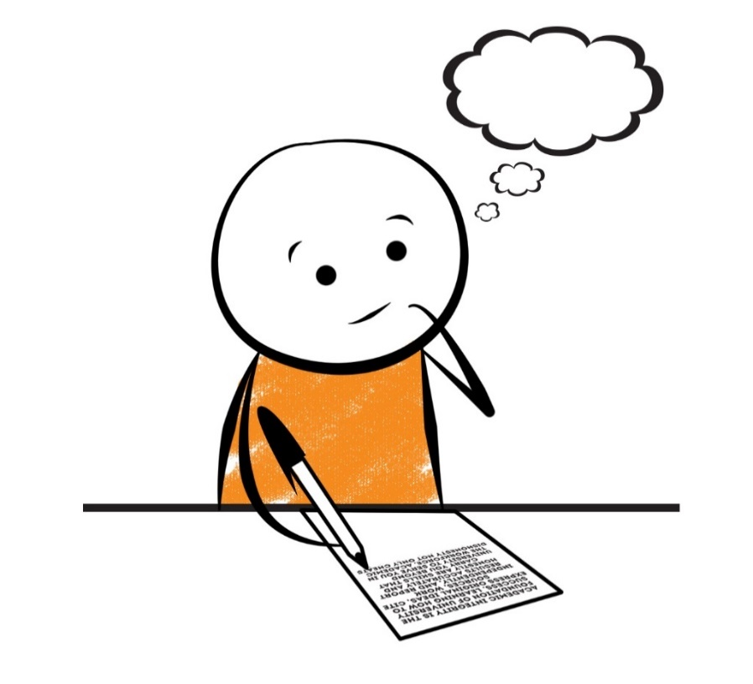
VIDEO

Slide 28
Day 3: read, write, revise
TWO IMPORTANT POINTS TO CONSIDER
Revision is not the same as editing
Drafting is not writing an entire essay from start to finish

Slide 29
Draft
What is a draft?
Everything you write down relating to this topic
What constitutes a first draft?
Any ideas you put on paper regardless of form
Drafts?
Each time you add or delete what you’ve written you’re creating a new draft
What constitutes a final draft?
When you’ve moved from revision to editing

Slide 30
What is a revision?
Changing the content
Overall idea – what am I saying?
Organization—what is the best way to say this?
Paragraphs – what am I saying in each?
Add to it
Delete from it
The purpose is to clarify your main point

Slide 31
Day 3 (or 8): read, think, revise…edit last!
Preferably, do your editing only when you are “finished” with the paper—perhaps on a separate day
Many writers revise and edit simultaneously, but it’s important to distinguish between the two—they are not the same work

Slide 32
Proofreading/Editing
When your focus is not on content, but on structure
Example:
Sentence structure: fragments, run-ons
Grammar: subject/verb agreement, verb tense, syntactical errors (comma splices, periods, question marks, exclamation points, semi-colons, commas, colons)
Spelling, word choice, word usage

Slide 33
Day 3 (or 8): read, think, revise…edit last!
End where you began—read what you wrote!
Evaluate your paper before someone else does:
PURPOSE (clear audience, subject, and genre)
DIRECTION (proper structure, organization, logical order)
IDEAS (connection to reader, specific details, variety)
STYLE (expression, word choice, sentence variety, figurative language, etc...)
PRESENTATION (spelling, punctuation, capitalization, paragraphing, neatness, pen or typed)
Is this a good reflection of what you can do?

Slide 34
YOU KNOW WHERE TO FIND US!
Carver Complex North, Hollins Wing, Rm 125
@thewriteplaceaamu
@writeplaceaamu
www.aamu.edu/writingcenter

