Slide 1
How to Help students think critically
A “Write Place” Faculty Workshop
Wednesday, January 15, 2020

Slide 2
In yesterday’s workshop…
THE STEPS NEEDED TO GET STUDENTS GOING DOWN THE “WRITE” PATH
Recognize the value of writing
Help students learn how to be deep readers
Create assignments that force critical thinking

Slide 3
IN TODAY’S WORKSHOP…
Understand the connection between thinking and writing
Look more closely at assignments that will prompt students’ critical thinking
Develop strategies for teaching how your discipline uses evidence to support claims

Slide 4
We will also address common concerns; for example that:
Integrating writing will take time away from content
Writing assignments are not appropriate for some disciplines
Assigning writing will bury the teacher in paper grading
Assigning writing requires specialized expertise

Slide 5
WRITING & CRITICAL THINKING
The connection between writing and thinking grows out of the constructivist view of knowledge that demands critical thinking rather than memorization.
This view sees knowledge as discovered rather than dispensed
A “dualistic” view sees knowledge as the acquisition of correct information and right answers.

Slide 6
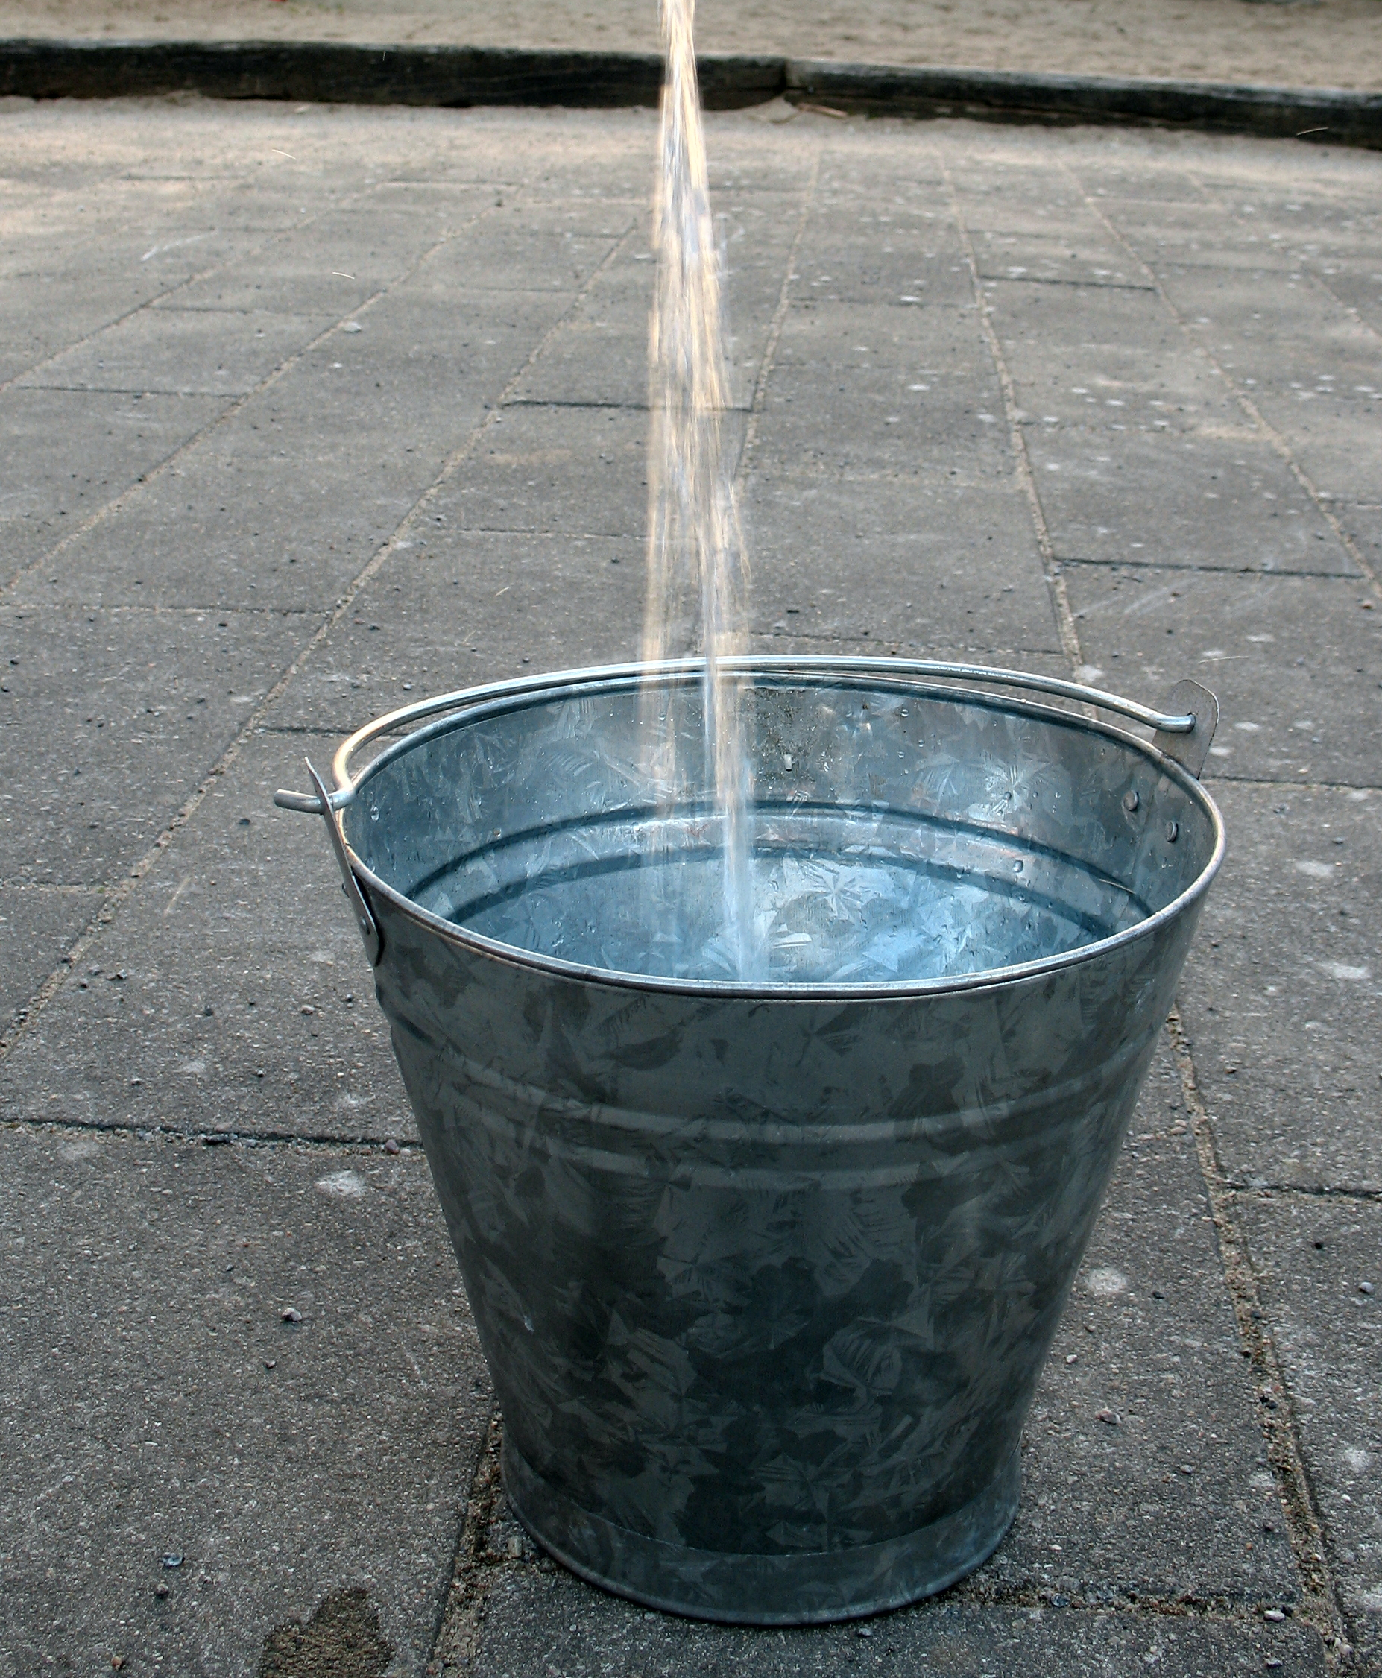
The problem with this view is that students see themselves as empty buckets being filled with data by professors
To dualists, the only academic use of writing is to demonstrate one’s knowledge of correct facts
A constructivist view, considers to what ends the facts will be used

Slide 7
The writing process provides one of the best ways to help students learn active, dialogic thinking skills valued in academic life
Thesis-governed writing evolves from the lengthy and messy process of drafting and redrafting
Writing as process encourages the messy process whereby writers become engaged with a problem and, once engaged, formulate, develop, complicate, and clarify their own ideas

Slide 8
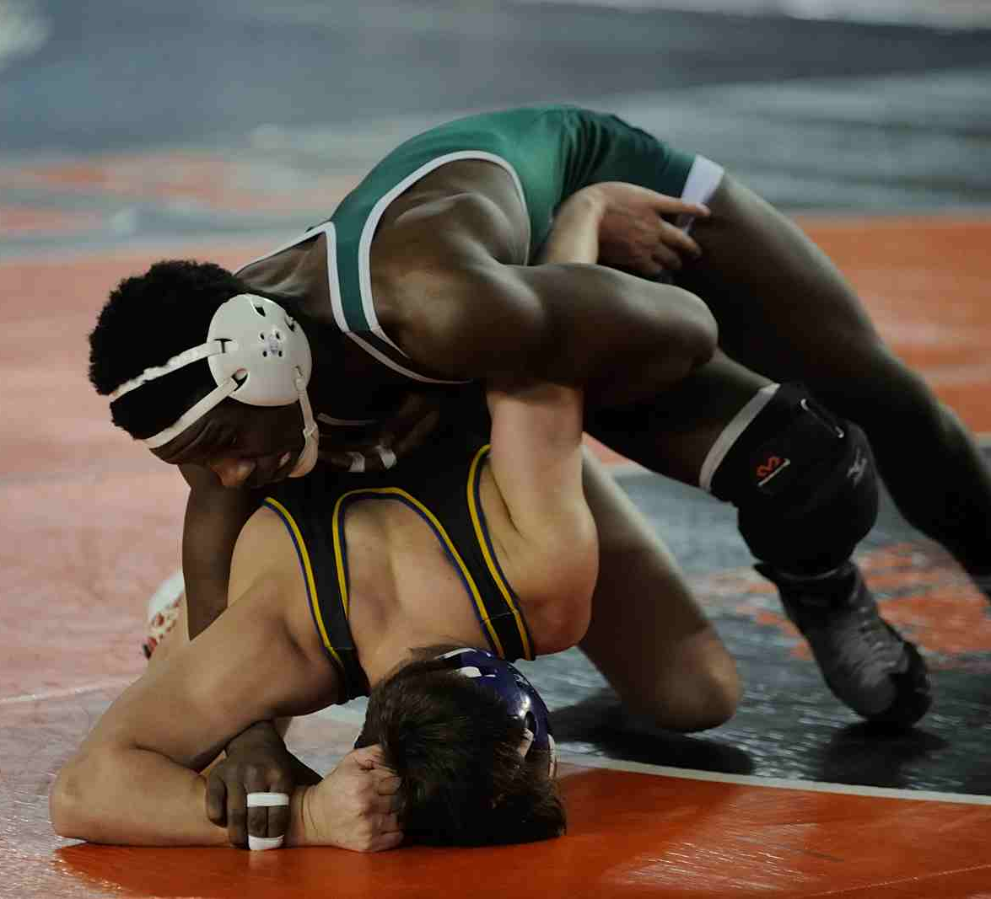
The goal of dialogic thinking skills is to identify the tension between multiple views and to wrestle with difficult problems
By wrestling with complex issues through writing, students are challenged to think more deeply about their subject matter than if they merely had to memorize and report!

Slide 9
Writing as a process… What does it mean?
We have mistaken it to mean that students walk through the process in lock-step
First they make an outline, then they write their introduction, then the body, then the conclusion
But this is not an accurate reflection of how writers write—professionals or amateurs!
In reality, writing is not linear, it’s recursive!
“writing is both a process of doing critical thinking and a product that communicates the results of critical thinking” (Bean 4)

Slide 10
Good writing begins with
Thoughts don’t typically come to us in order
How often do we see students’ thesis coming clear by the end of their paper?
We need to make revision part of the assignment

Slide 11
REVISION
To revise does not mean to edit—it means to look again!
Deals with higher-order concerns
Looks at the function of thesis compared to the body
Considers the rhetorical situation

Slide 12
We have mistakenly substituted “the rich, creative source of ideas” for “sterile order that leaves us obsessed with correctness, neatness, and propriety. The message from our schools has often been that writing is a joyless activity, an opportunity mainly for displaying errors for teachers to red-pencil” (Bean 18)

Slide 13
What kinds of assignments make students think?
Assignments that generate critical thinking are those that push students to actually take part in the recursive writing process
NSSE and WPA research shows that “the number of writing assignments in a course may not be as important as the design of the writing assignments themselves.” (Bean 1)
In yesterday’s workshop we introduced the RAFT and the TIP

Slide 14
Raft & tip… revisited!
ROLE (purpose): how will the student affect audience?
Inform?
Persuade?
Clarify?
AUDIENCE : if the audience is only the teacher, they will have a limited concept of how language works in “real life”
Help students visualize the audience’s initial stance towards the subject
Teacher’s goal is to move students toward tension:
“Many people think X,
but I am going to argue Y”

Slide 15
FORMAT by specifying a genre (academic paper, op-ed, memo, proposal, experimental report) the assignment helps students transfer earlier genre knowledge to the current task.
TASK sets forth the subject matter dimension of assignment. For thesis-driven essays requiring disciplinary ways of thinking and arguing, tasks are best presented as disciplinary problems that the teacher provides.

Slide 16
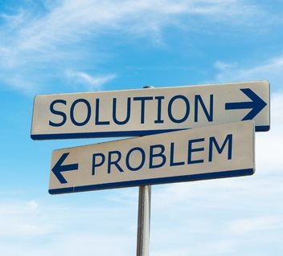
“intriguing, beautiful or important problems [and] authentic tasks…will challenge [students] to grapple with ideas, rethink their assumptions, and examine their mental models of reality.”
If writing is only communication, the only question we can ask is “is it clear?”
If writing is process and product of critical thinking we can ask “is the writing interesting? Does it show a mind actively engaged with a problem? Does it bring something new to readers? Does it make an argument? Does it do something?

Slide 17
Experienced writers begin by posing two kinds of problems: subject matter and rhetorical (p. 4)
The key to designing effective assignments is to develop good problems for students to think about. (Bean 6)
“Good” problems are those that align with disciplinary problems broadly and/or course objectives specifically
The kinds of questions you develop should also be appropriate for their level of expertise

Slide 18
Macdonald’s four stages of student development as writers
Nonacademic writing (what students bring from high school)
Generalized academic writing (freshman comp)
Novice approximations of particular disciplinary ways of making knowledge (early courses in major)
Expert, insider prose (advanced courses in the major)

Slide 19
Complex skills required for research
How to ask discipline-appropriate research questions
How to establish a rhetorical context (audience, genre, purpose)
How to find sources
Why to find sources
How to integrate sources into paper
How to take thoughtful notes
How to cite/document

Slide 20
Give students assignments with stakes!
Propose a proposition (thesis) for students to defend or refute
Give students a problem or question that demands student’s “best solution” answer
Assign a thesis-governed paper requiring analysis of raw data
Create summary/response assignments based on one or more scholarly articles
This Photo by Unknown Author is licensed under CC BY-ND

Slide 21
Reconceptualize “research”
Bizup’s BEAM fleshes out “primary” and “secondary” sources in order to illuminate the actual function of sources within the writer’s argument
Background
Exhibits/Evidence
Argument sources
Methods
(see handout)

Slide 22
TASKS

Slide 23
Other ways to incorporate writing
Separate high stakes from low-stakes writing
Low-stakes are good for exploring and externalizing thoughts:
Journal-writing
Drafting
Homework questions
Discussion board posts
Small group tasks
“Bell ringers” or starters for class discussion
Class debates, panels and “fishbowls”
Practice exam questions

Slide 24
High stakes—allow more time for these, let low-stakes activities feed into high stakes assignments
Essay exams
Research papers

Slide 25
DON’T LET THEM OFF THE HOOK!
“when given a critical thinking problem, [students] tend to reach closure too quickly. They do not suspend judgment, question assumptions, evaluate evidence, imagine alternative answers, play with data, enter into the spirit of opposing views, and just plain linger over questions. As a result, they often write truncated and underdeveloped papers” (Bean 8)
Give students time for exploration and reflection:
Aim for “reflective tasks…[that encourage] students to think metacognitively about their own thinking processes, to connect learning in one course to other courses or to their own lives, to transfer skills from one setting to another and to integrate their learning.”

Slide 26
Neither we nor our students need to think too narrowly about writing—help them understand that it doesn’t end after Freshman Comp
students need to learn how different disciplines use evidence to support arguments:
“Some disciplines derive their evidence from observation of natural or cultural phenomena, sometimes converted to numbers, subjected to statistical analysis, and displayed in graphs and tables. Other disciplines use qualitative data from ethnographic observations, focus group transcripts, or interviews. Still others analyze aural, visual, or verbal texts housed in libraries, historical archives, art galleries, museums, etc.” (9)
Students need to “see how these different kinds of data function as evidence in support of a claim” (9)

Slide 27
METACOGNITIVE MAP OF DISCIPLINES
See handout

Slide 28
Concerns about integrating writing
Takes away time from content
Choose quality over quantity
Consider that, in the long run, learning how to learn will be more beneficial than just learning how to do something
Writing helps them to learn content more deeply
Unsuitable for my course
Re-think your concept of writing
Align writing tasks with metacognitive or procedural aims
I’ll be buried in papers
Plan your courses to include what you can handle
You don’t have to read (or grade) everything they write!

Slide 29
4. I’m not knowledgeable
The goal is to teach students how to think critically
Respond to student writing with an eye towards writing as a process
Think about your own process and what you do to revise, then offer that kind of feedback to students
By giving low-stakes writing assignments that you can comment on in regards to content and form, you are helping them understand expectations and process and forcing them think about understanding the subject matter, not just communicating (regurgitating) information

Slide 30
PARTNER WITH US!
The Write Place is a resource for you and your students:
We can give feedback on course design
Offer suggestions for writing assignments
Let you know what your students are struggling with
Help your students understand the writing process
Provide resources/workshops on the grammatical and mechanical issues so you don’t have to

