Slide 1

GET ORGANIZED!
A “Write Place” Workshop

Slide 2
LET’S RECAP!
What we know about writing…

Slide 3
WHAT IT’S NOT
Linear
intro, body, conclusion

Slide 4
WHAT IT IS
Recursive
questioning, thinking, drafting

Slide 5

NOW WHAT?

Slide 6
TIME TO ORGANIZE!
What is your purpose?
Who is your audience?
What is the required genre/format?

Slide 7
THESIS
Main point
Establishes direction/focus
Sets the stage/blueprint for the paper
You may have a “working thesis” during the drafting phase*

Slide 8
Analytical
An analytical paper breaks down an issue or an idea into its component parts, evaluates the issue or idea, and presents this breakdown and evaluation to the audience.

Slide 9
Analytical Thesis Example
An analysis of the college admission process reveals one challenge facing counselors: accepting students with high test scores or students with strong extracurricular backgrounds.

Slide 10
The paper that follows should…
explain the analysis of the college admission process
explain the challenge facing admissions counselors

Slide 11
Expository
An expository (explanatory) paper explains something to the audience

Slide 12
Expository Thesis example
The life of the typical college student is characterized by time spent studying, attending class, and socializing with peers.

Slide 13
The essay that follows should…
Explain how students spend their time studying, attending class, and socializing with peers

Slide 14
Argument
An argumentative paper makes a claim about a topic and justifies this claim with specific evidence. The claim could be an opinion, a policy proposal, an evaluation, a cause-and-effect statement, or an interpretation. The goal of the argumentative paper is to convince the audience that the claim is true based on the evidence provided.

Slide 15
An argument thesis example
High school graduates should be required to take a year off to pursue community service projects before entering college in order to increase their maturity and global awareness.

Slide 16
The essay that follows should…
Present an argument and give evidence to support the claim that students should pursue community projects before entering college

Slide 17
BODY
Made up of paragraphs
Each paragraph is a unit—topic sentence/supporting sentences
Like a miniature essay—thesis/supporting paragraphs
One point per paragraph only!
Must support/prove thesis

Slide 18
Outlines/Maps
Put like things together
Think about progression—what happens first, second, third
Consider audience…what would make the most sense to think about first?
Use the known/unknown structure

Slide 19
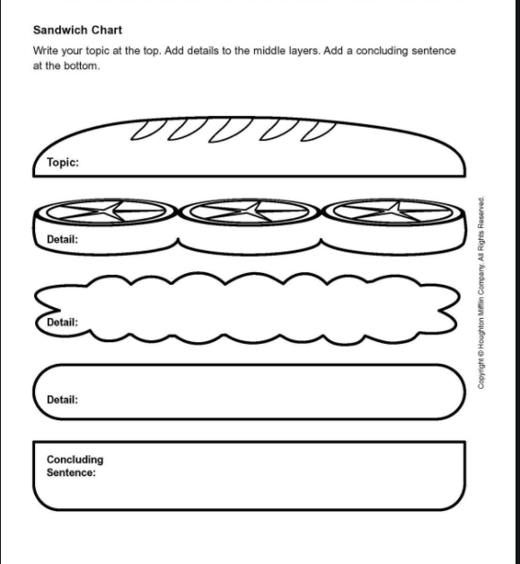
Make a Sandwich!

Slide 20
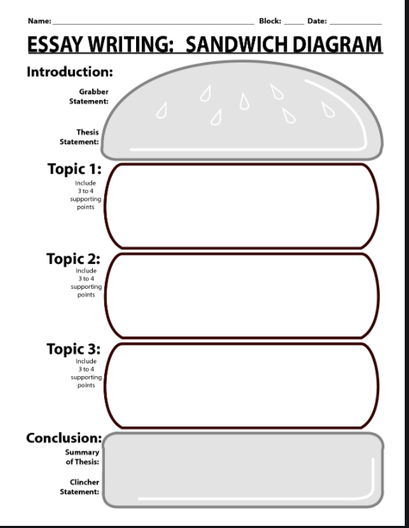

Slide 21

Linking

Slide 22
Wrap it Up!
End the way you began!

Slide 23

Let us help you!
www.aamu.edu/writingcenter
BEFORE YOU GO…
PLEASE COMPLETE THE SURVEY!

