Slide 1
The Writing Process
A “Write Place” Workshop by
Dr. Kem Roper, Director
January 28, 2020

Slide 3
Writing is an act of surrender…
You have to approach your writing task with an attitude of openness and expectation
Set aside pre-conceived ideas or negative attitudes
Don’t begin by saying “I’m no good at this!”

Slide 4
Also keep in mind that writing is not going away. You will have to do it again and again…
You might as well surrender to the process!

Slide 5
Try Re-framing
Rather than throwing out writing all together, think about the ways that writing is useful
Maybe you don’t like to write essays, but in what other ways do you use writing to accomplish goals?
Thinking about the value of writing in use helps to diminish the negative attitudes we may have about it
Also, think about the purpose of this writing assignment. It’s not just for the teacher, it’s meant to teach you something!

Slide 6
So, how do I begin?
Give yourself AT LEAST 3 days before the due date to write
Give yourself a different task for each day
Be free! Save editing for the last day

Slide 7
If you only have 3 days…
Day 1: think, pray, write
Day 2: think, write, re-write
Day 3: think, revise, edit (print & rejoice!)
Space out your work! Don’t try to do it all in one sitting

Slide 8
If you have more than 3 days…
Day 1-3: think, pray, write
Day 3-5: think, write, re-write (read and take notes if doing research)
Day 5-7: think & revise
Day 8: edit, print & rejoice!

Slide 9
LET US HELP!
The best time to come to the writing center is early in your process.
We do our best work at the beginning!

Slide 10
Day 1: think, pray, write
What is your topic?
What is required?
What do I already know about this?
What opinions do I have about this?
Where do my thoughts and opinions come from?
Experiences, observations, personality, family/upbringing

Slide 11
Answer these questions by:
Free-writing
Listing (or clustering)
Speaking into recorder
Conversing
Generate Ideas:
5Ws (journalist questions)
5 Senses (Look, Touch, Taste, Feel, Smell)

Slide 12
PRACTICE!

Slide 13
Day 2: think, write, re-write
If you’re writing a research paper, DAY 2 should be spent reading & taking notes on the reading (Go to the “Write Place” website for Powerpoint slides on research writing)
If you have a long research paper to write, your “day 2” may need to stretch out to day, 3, 4 and 5!

Slide 14
Day 2: if you’re doing research…
Your question to yourself should be: how does this information compare to what I already know?
Does it confirm, refute or enrich my understanding of this topic?
Write down your answers to these questions!

Slide 15
If you’re not doing research or once you’ve read and taken notes on your reading…
Think about what you have written and how it can be structured
Add to what you wrote on Day 1—can you say more?
To determine what to keep and what to toss, consider your purpose and audience

Slide 16
How do I “Say More?”
Try this!
Think about the main point that you want to make
Can you find a working thesis in your draft so far?
Take one statement that asserts a point/perspective and follow the S.E.E.I formula to develop

Slide 17
S.E.E.I
State—write the statement
Elaborate—follow with an elaboration on that statement (“in other words…”)
Exemplify—give an example that shows an actual instance of that thing
Illustrate—give an illustration that compares that thing to something that it’s “like”

Slide 18
SEEI Example
State—Writing is as much about learning as it is about writing.
Elaborate—Thoughts come to us randomly, sporadically and at different times, so we have to take the time to think things through.
Exemplify—When I have a paper to write, I spend a lot of time figuring out what I want to say. My ideas are usually all over the place at first, so I have to make lists or free write for a while before I actually start.
Illustrate—Writing is like organizing your sock drawer. You have to dump out all the ideas first, then put them together one by one until all of the like things are together!

Slide 19
SEE-I
Now you try!

Slide 20
Organize!
Once you have some “stuff” to work with you can begin organizing what you’ve written
This is when a reverse outline can be very helpful
Now is the time to think about the structure of your essay
Who is your audience?
What does the professor require?

Slide 21
Day 3: think, revise…edit
Outline
Thesis (what is my main point?)
Introduction (how can I set up this discussion?)
Background Information (what information would my reader need in order to know what I know?)
Supporting Information (what will I use to support my main point?)
details, examples, research

Slide 22
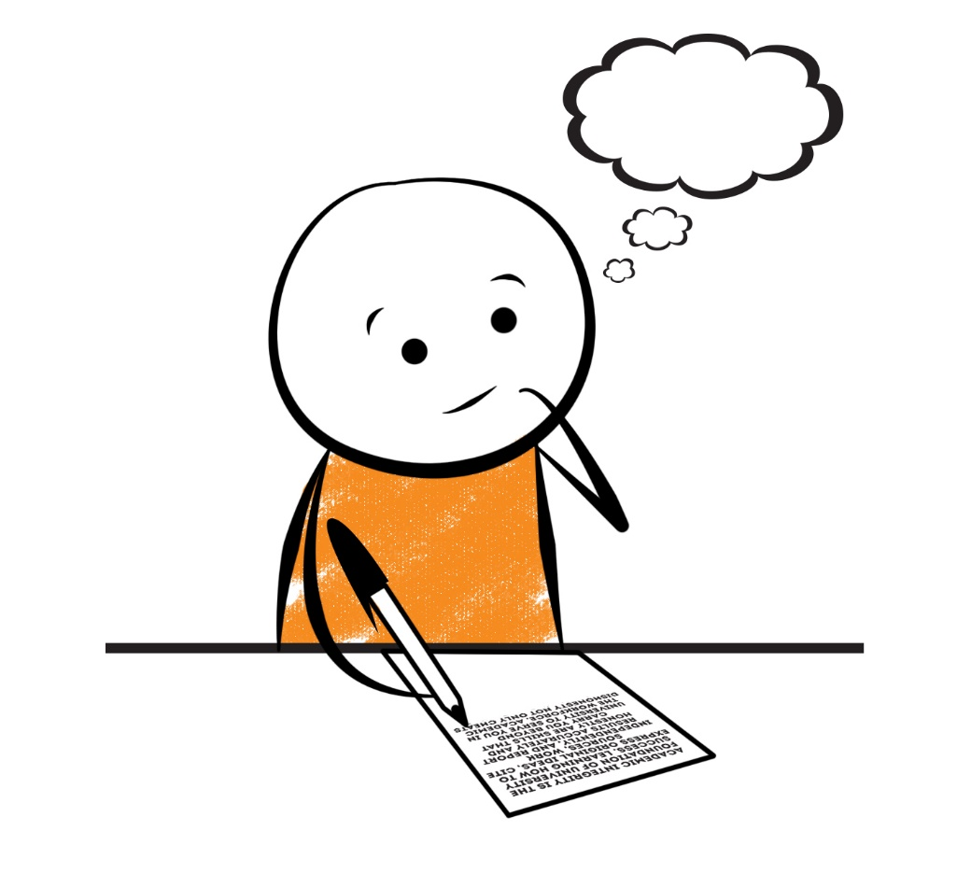
PRACTICE!

Slide 23
Draft
What is a draft?
Everything you write down relating to this topic
What constitutes a first draft?
Any ideas you put on paper regardless of form
Drafts?
Each time you add or delete what you’ve written you’re creating a new draft
What constitutes a final draft?
When you’ve moved from revision to editing

Slide 24
What is a revision?
Changing the content
Overall idea – what am I saying?
Organization—what is the best way to say this?
Paragraphs – what am I saying in each?
Add to it
Delete from it
The purpose is to clarify your main point

Slide 25
Proofreading/Editing
What is proofreading and editing?
When your focus is not on content, but on structure
Example:
Sentence structure: fragments, run-ons
Grammar: subject/verb agreement, verb tense, syntactical errors (comma splices, periods, question marks, exclamation points, semi-colons, commas, colons)
Spelling, word choice, word usage

Slide 26
Reflections
Evaluate your paper first before someone else does:
PURPOSE (clear audience, subject, and genre)
DIRECTION (proper structure, organization, logical order)
IDEAS (connection to reader, specific details, variety)
STYLE (expression, word choice, sentence variety, figurative language, etc...)
PRESENTATION (spelling, punctuation, capitalization, paragraphing, neatness, pen or typed)
Is this a good reflection of what you can do?

Slide 27
YOU KNOW WHERE TO FIND US!
Carver Complex North, Hollins Wing, Rm 125
@thewriteplaceaamu
@writeplaceaamu
www.aamu.edu/
writingcenter

