Slide 1
The Writing Process “Think, Pray, Write”
AAMU Writing Center
The “Write Place”
Dr. Kem Roper, Director
November 13, 2019

Slide 2
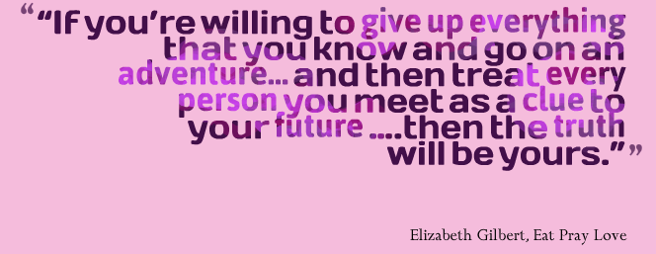

Slide 3
Writing is an act of surrender…
You have to approach your writing task with an attitude of openness and expectation
Set aside pre-conceived ideas or negative perspectives
Don’t begin by saying “I’m no good at this!”

Slide 4
Also keep in mind that writing is not going away. You will have to do it again and again…
You might as well surrender to the process!

Slide 5
So, how do I begin?
Give yourself AT LEAST 3 days before the due date to write
Give yourself a different task for each day
Be free! Save editing for the last day

Slide 6
If you only have 3 days…
Day 1: think, pray, write
Day 2: think, write, re-write
Day 3: think, revise, edit (print & rejoice!)
Space out your work! Don’t try to do it all in one sitting

Slide 7
If you have more than 3 days…
Day 1-3: think, pray, write
Day 3-5: think, write, re-write (read and take notes if doing research)
Day 5-7: think & revise
Day 8: edit, print & rejoice!

Slide 8
Day 1: think, pray, write
What is your topic?
What is required?
What do I already know about this?
What opinions do I have about this?
Where do my thoughts and opinions come from?
Experiences, observations, personality, family/upbringing

Slide 9
Answer these questions by:
Free-writing
Listing (or clustering)
Speaking into recorder
Conversing
Generate Ideas:
5Ws (journalist questions)
5 Senses (Look, Touch, Taste, Feel, Smell)

Slide 10
PRACTICE!

Slide 11
Day 2: think, write, re-write
If you’re writing a research paper, DAY 2 should be spent reading & taking notes on the reading
If you have a long research paper to write, your “day 2” may need to stretch out to day, 3, 4 and 5!

Slide 12
Day 2: if you’re doing research…
You’re question to yourself should be: how does this information compare to what I already know?
Does it confirm, refute or enrich my understanding of this topic?
Write down your answers to these questions!

Slide 13
If you’re not doing research or once you’ve read and taken notes on your reading…
Think about what you have written and how it can be structured
Add to what you wrote on Day 1—can you say more?
Begin organizing what you’ve written
This is when an outline or reverse outline would be helpful

Slide 14
Write - Outline
Outline
Why? Purpose
Why? Format
Why? Organization and Planning
Why? Major Points
Why? Details and Examples (personal knowledge/experience & research)

Slide 15
Day 3: think, revise…edit
Fill in – Outline
Thesis (what is my main point?)
Introduction (how can I set up this discussion?)
Background Information (what information would my reader need in order to know what I know?)
Supporting Information (what will I use to support my main point?)
details, examples, research

Slide 16
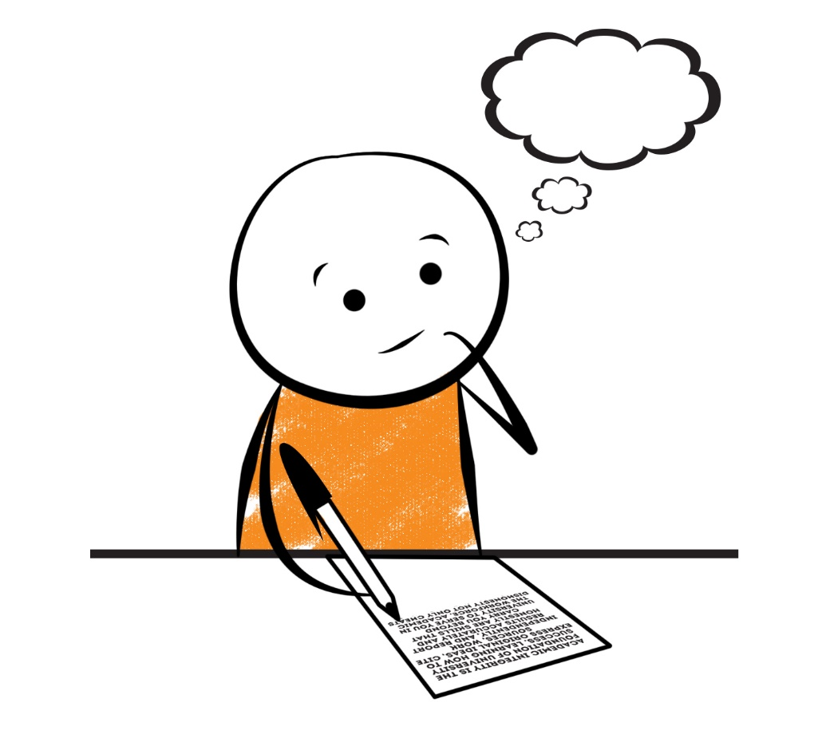
PRACTICE!

Slide 17
Draft
What is a draft?
Everything you write down relating to this topic
What constitutes a first draft?
Any ideas you put on paper regardless of form
Drafts?
Each time you add or delete what you’ve written you’re creating a new draft
What constitutes a final draft?
When you’ve moved from revision to editing

Slide 18
What is a revision?
Changing the content
Overall idea – what am I saying?
Organization—what is the best way to say this?
Paragraphs – what am I saying in each?
Add to it
Delete from it
The purpose is to clarify your main point

Slide 19
Proofreading/Editing
What is proofreading and editing? Grammatical errors
Sentence structure: fragments, run-ons
Grammar: subject/verb agreement, verb tense, syntactical errors (comma splices, periods, question marks, exclamation points, semi-colons, commas, colons)
Spelling, word choice, word usage

Slide 20
Reflections
Evaluate your paper first before someone else does:
PURPOSE (clear audience, subject, and genre)
DIRECTION (proper structure, organization, logical order)
IDEAS (connection to reader, specific details, variety)
STYLE (expression, word choice, sentence variety, figurative language, etc...)
PRESENTATION (spelling, punctuation, capitalization, paragraphing, neatness, pen or typed)
Is this a good reflection of what you can do?

