Slide 1
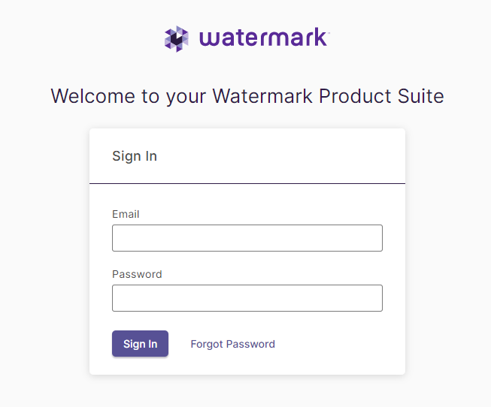
Logging into Planning and Self Study is Easy!
NOTE TO SYSTEM ADMIN: PLACE SCREENSHOT OF SSO LOGIN PAGE HERE or use the screenshot and steps below.
End user password creation:
Go to login.watermarkinsights.com
Click Forgot Password.
Enter institution email address.
Check your email for link to set password.

