Slide 1
Preparing for your Departmental Assessment Workshop
Office of Institutional Planning, Research, and Effectiveness
Fall 2017

Slide 2
Overview
Modifications in the Assessment Process
Disaggregation of Data for Online & Off-Site Learners
Preparing for your Departmental Assessment Workshop
Assessment Report Timeline
OIPRE Assessment Report Inventory
OIPRE Assessment Report Audit

Slide 3
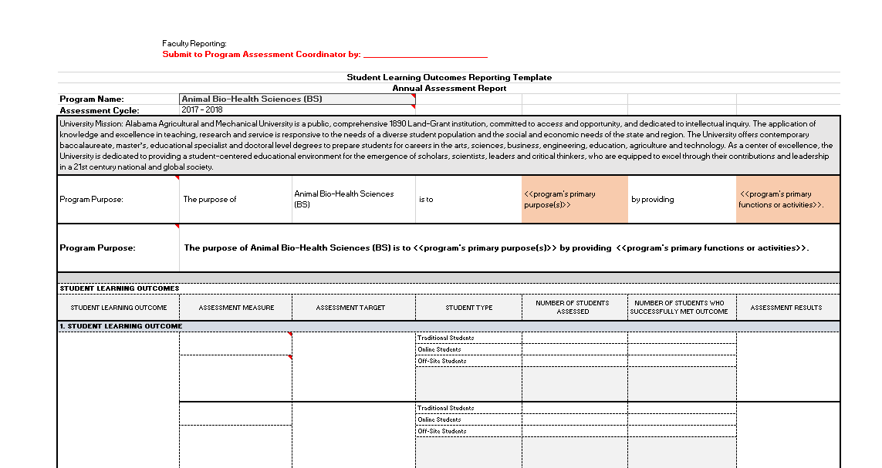
Modifications: Faculty Template

Slide 4
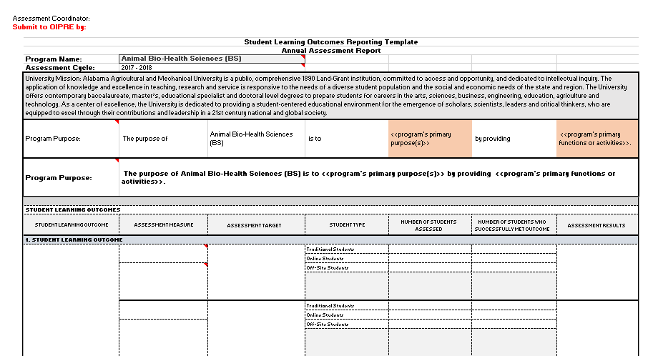
Modifications: Assessment Coordinator Template

Slide 5
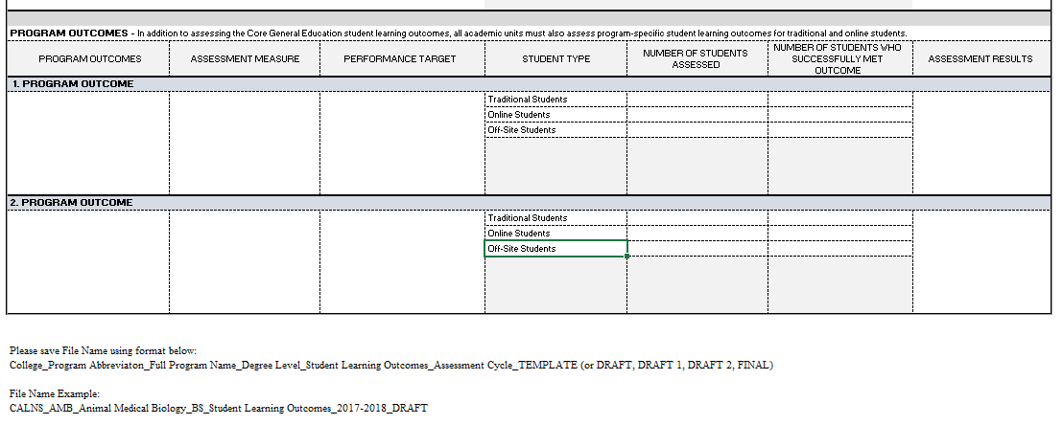
Modifications: Assessment Coordinator Template

Slide 6
SPOL Implementation
Assessment and Accreditation Modules
OIPRE SPOL Training 10/12/17
SPOL integration anticipated January 2018
2017 SPOL Conference
October 22-25, 2017
Intensive Assessment Modules Workshops

Slide 7
SPOL Implementation
Faculty Perspective

Slide 8
Disaggregation of Data for Online & Off-Site Learners
The following text was extracted from page 5 of the Principles of Accreditation:
The Commission on Colleges bases its accreditation of degree-granting higher
education institutions and entities on requirements in the Principles of
Accreditation: Foundations for Quality Enhancement. These requirements apply to all institutional programs and services, wherever located or however delivered. This includes programs offered through distance and correspondence education, off-campus sites, and branch campuses.

Slide 9
Disaggregation of Data for Online & Off-Site Learners
2015 – 2016 Outcomes Reports
Modify
2016 – 2017 Outcomes Reports
Complete
2017 – 2018 Outcomes Plans
Complete
Submission Deadline, November 13, 2017

Slide 10
Faculty Preparation for Departmental Assessment Workshop
Faculty:
Please bring your laptops to Assessment Workshops
Migrate SLO’s to new faculty template
Please sign-up to have faculty template emailed to you today
Add your name, email, and program
Email rubrics and grading tools to OIPRE
Parisa.Naghshpour@aamu.edu
Submission Deadline, November 13, 2017

Slide 11
Preparing for your Departmental Assessment Workshop
Faculty:
Locate historical data & Rubrics/Grading Tools:
Traditional students
Online students
Off-site students
2015 – 2016 Outcomes Reports
2016 – 2017 Outcomes Reports
2017 – 2018 Outcomes Plans
Submission Deadline, November 13, 2017

Slide 12
Assessment Coordinator Preparation for Departmental Assessment Workshop
Assessment Coordinators:
Migrate SLO’s AND Program Outcomes to new Program template
Please sign-up to have program template emailed to you today
Add your name, email, and program
Submission Deadline, November 13, 2017

Slide 13
Assessment Timeline Departmental Assessment Workshops
October, 2017 – November 10, 2017
Tuesdays & Thursdays
12:30 – 2:00p
Please schedule promptly.
Other days & times available per academic unit availability, please contact to schedule.
Submission Deadline, November 13, 2017

Slide 14
OIPRE Assessment Inventory & Audit Timeline
OIPRE Assessment Inventory
Begins: November 13, 2017
Completion: November 17, 2017
OIPRE Assessment Audit
Begins: November 27, 2017
Completion: December 8, 2017

Slide 15
OIPRE Assessment Inventory & Audit
Adapted from Assessment Audit created by Dr. Mary Harrington, University of Mississippi
OIPRE Deadlines to Return Inventory & Audit Results to Departments:
Assessment Inventory (initial receipt) – November 17, 2017
Assessment Audit (quality) – December 8, 2017

Slide 16
OIPRE Spring 2018 Workshops
Tentative Schedule
March – April, 2018
SPOL Implementation
Curriculum Mapping
Completion of 2017 – 2018 Assessment Cycle Reports
Faculty (Assessment Units) interpretation of Assessment Results
Faculty (Assessment Units) application of Assessment Results

Slide 17
OIPRE Contact Information
Dr. James Walke, Director
James.Walke@aamu.edu
(256) 372-8876
Ms. Parisa Naghshpour,
Assessment Coordinator
Parisa.Naghshpour@aamu.edu
(256) 372-8122
Office of Institutional Planning, Research and Assessment, 306 Patton Hall

